Slide 1
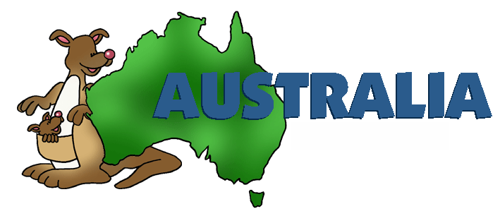

Slide 2
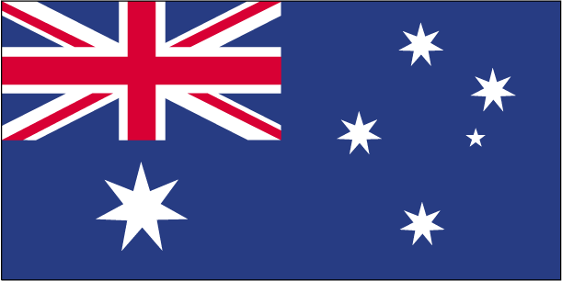
Australian flag

Slide 3
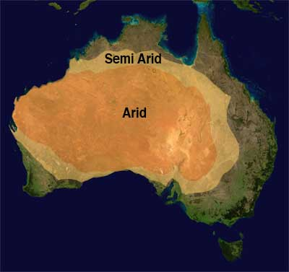
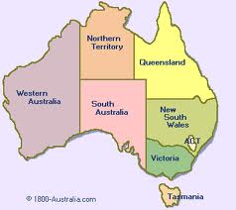
Australia is :
The hottest, the driest and the flattest continent.
The only country that is a continent.

Slide 4
Australia is often called Down Under.
People living in Australia are called Aussies.
Population: 22,864,922
Australian capital is Canberra (358,222)
The biggest city is Sydney (4,575,532)
The second biggest city is Melbourne (about 3million of people).

Slide 5
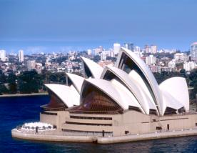
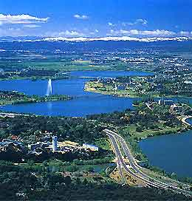
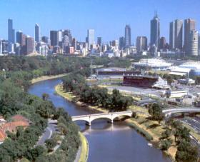
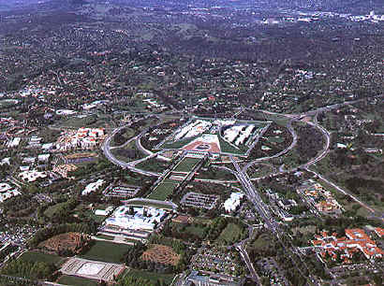
Canberra, the capital city
Sydney
Melbourne

Slide 6
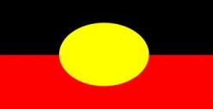
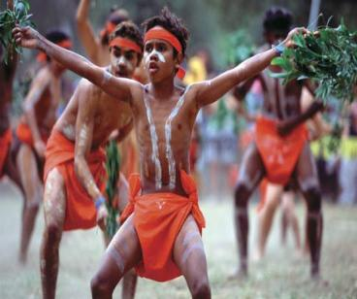
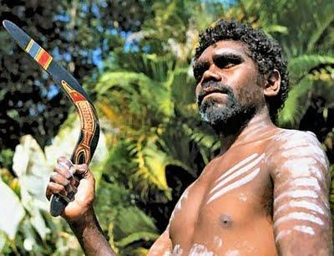
PEOPLE
Archaeologists believe that the Aborigines first came to the Australian continent around 45,000 years ago.

Slide 7
Aborigines were nomads who moved from place to place looking for food.
They believed in “oneness” with nature
They were telling stories about the Dreamtime (time when powerful spririts created the land and the people)

Slide 8
aborigine
ab origine, lat., literally "from the beginning” (http://www.etymonline.com)
The word aboriginal was used to describe the native people, people who lived in the countries colonized by the Europeans.

Slide 9
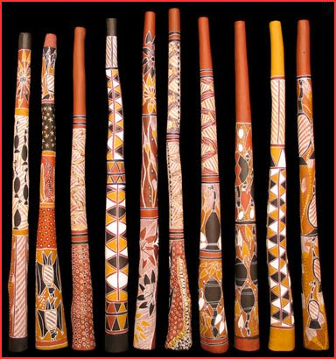
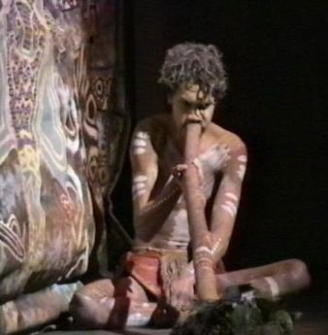
The didgeridoo
A traditional Aboriginal wind instrument

Slide 10
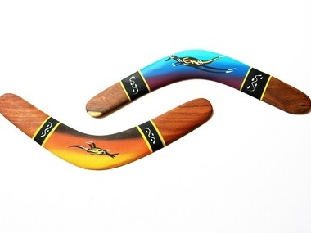
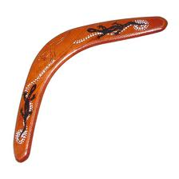
boomerang
A boomerang is a flying tool, curved in shape and used as a weapon or for sport.

Slide 11
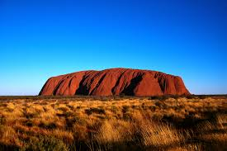
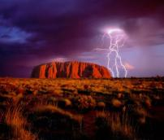
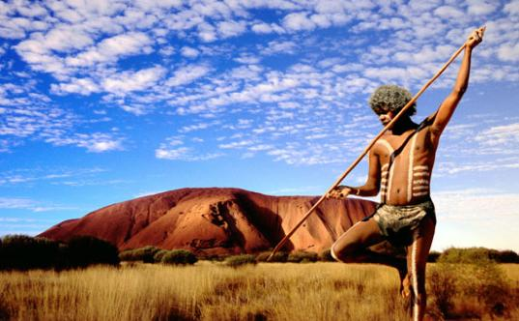
ULURU or Ayers Rock - large sandstone rock formation in central Australia.
Aborigines still believe it is a mystical place.

Slide 12
Settlers
IN 1787 the English government sent the first settlers to Australia. Most of them were convicts.
The first colony on the “new” continent was Sydney.
In 1850s, after the discovery of gold more people came.
Today, Australia has immigrants from all over the world.

Slide 13
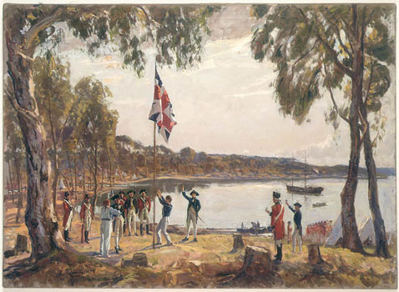
When white settlers arrived, they took away the land and destroyed the Aboriginal way of life.
Today, less than 1% of Australians are Aborigines.

Slide 14
language
There is NO official language in Australia, but most people speak English.
Australian English is called Strine and it is slightly different than British or American English
Can you guess what do these words and expressions mean?
telly, postie, brekkie, chalkie, sunnies
barbie, spag bol, polly, mystery bag
C’mon mate, have a go! G’day mate!
She’s apples! Good on ya!
Wanna rage?
Whadayawant? Howyagoing?

Slide 15
telly, postie, brekkie, chalkie, sunnies
barbie, spag bol, polly, mystery bag
C’mon mate, have a go!
G’day mate!
She’s apples!
Good on ya!
Wanna rage?
Whadayawant?
Howyagoing?
A TV, a postman, breakfast, a teacher, sunglasses
a barbecue, spaghetti bolognese, a politician, a sausage
Come on friend, try it!
Good afternoon, friend!
She is beautiful.
Well done!
Do you want to drink with me until we both drop?
What would you like? What do you need?
How are you? How is it going? What’s up?

Slide 16
Some more Strine.....
rego | Car registration
sanger | Sandwich
kindie | Kindergarten
mozzie | Mosquito
roo | Kagaroo
ambo | Ambulance
brekkie | breakfast
Fair dinkum! | Honest
Buckley’s chance | No chance
Drink with the flies | Drink alone
Mystery bag | Sausage
Belt up! | Shut up!
Good on ya! | Well done!
She’s apples! | She’s fine!
Dead horse! | Tomato sauce

Slide 17
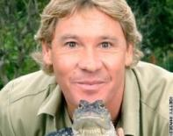
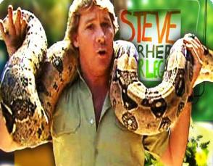
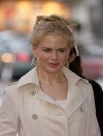
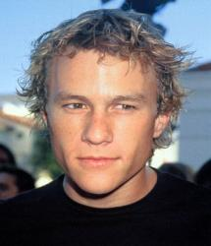
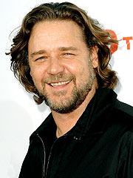
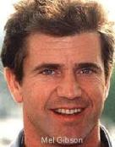
Famous Australians...
Steve Irwin, the Crocodile Hunter

Slide 18
Can you name some peculiar animal species that live only in Australia?

Slide 19
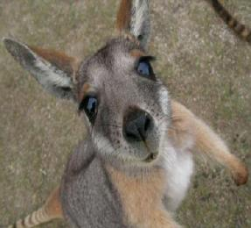
A KANGAROO

Slide 20
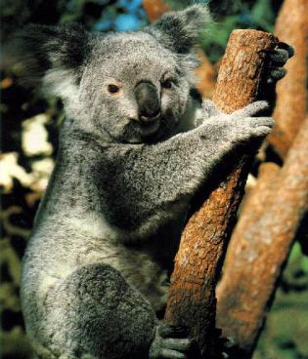
A KOALA BEAR
Koala bears don’t need water. They drink water only when they are ill.
They eat poisonous eucalyptus leaves.

Slide 21
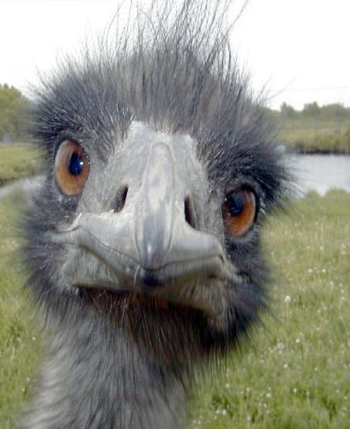
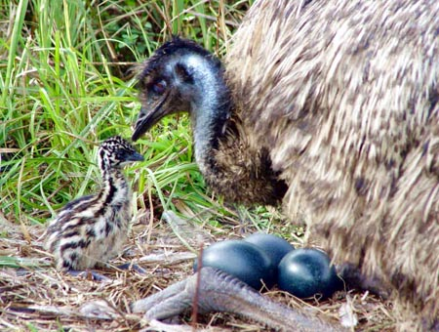
AN EMU

Slide 22
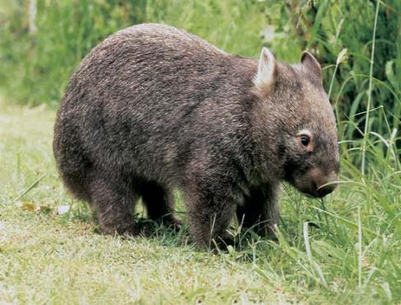
A wombat

Slide 23
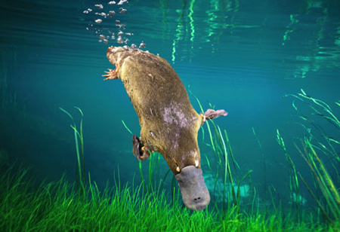
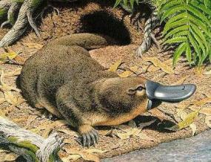
A platypus
When Europeans
first saw
a platypus they
thought it was a joke!
This small, amphibious mammal has a tail like a beaver, a body like an otter, walks like a reptile, has webbed feet and a beak like a bird, and it lays eggs!

Slide 24
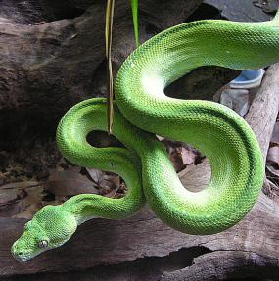
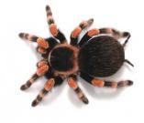
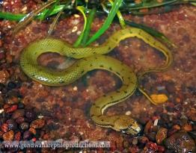
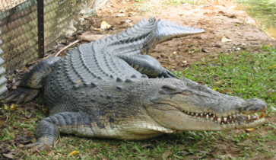
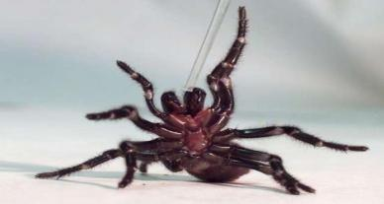
A lot of very dangerous animals live there too.

Slide 25
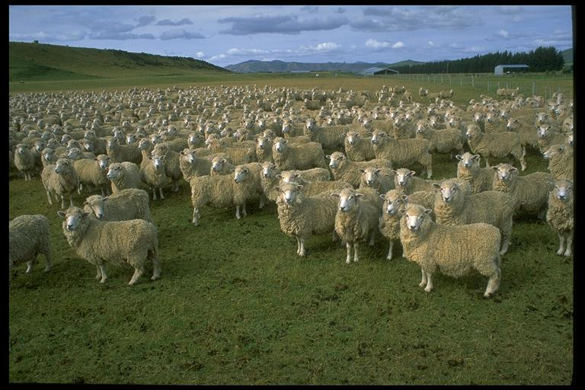
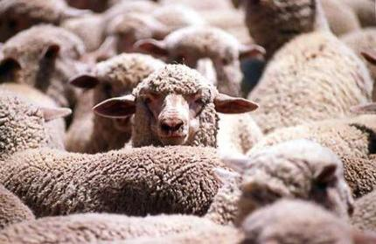
There is more sheep than people in Australia.
Australia exports more wool than any onther country in the world.

Slide 26
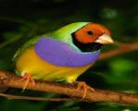
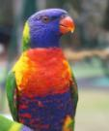
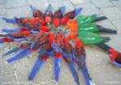
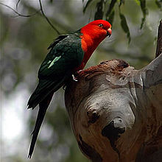
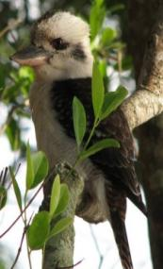
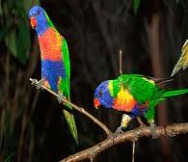
birds
There are 400 birds which you can ONLY see in Australia.
It explains why BIRDWATCHING is one of the most popular hobbies in Australia.
KOOKABURRA or LAUGHING BIRD

Slide 27
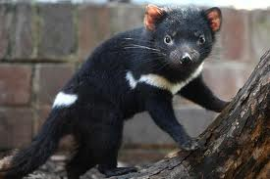
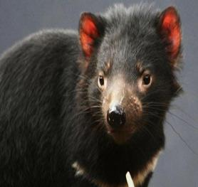
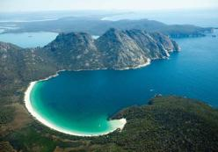
And who is this?
A Tasmanian Devil, a unique animal that lives in Tasmania.
Tasmania is an Australian island state.

Slide 28
SOURCES:
Way to go 5, Školska knjiga, Zagreb
wikipedia.org
L.K. 2012.

