Slide 1
Halloween
Origins and Traditions

Slide 2
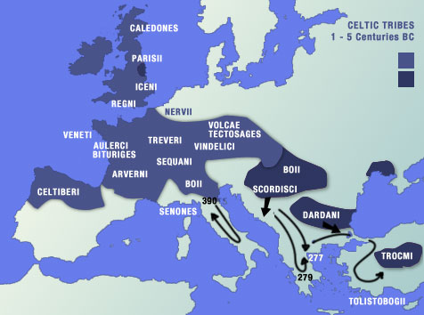
Origins
Halloween began two thousand years ago in Ireland, England, and Northern France with the ancient religion of the Celts (Paganism).

Slide 3
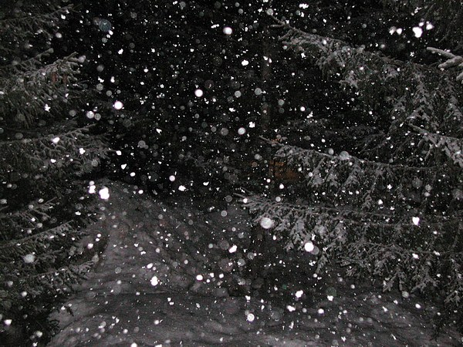
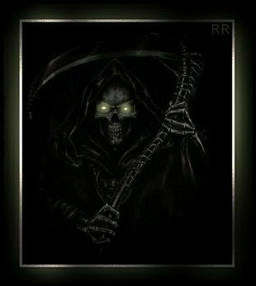
They celebrated their New Year on November 1st.
This day marked the beginning of the dark, cold winter, a time of year that was often associated with human death.

Slide 4
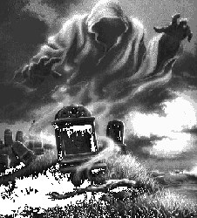
Samhain (sow-in)
On the night of October 31, they celebrated Samhain, when it was believed that the ghosts of the dead returned to earth.

Slide 5
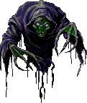
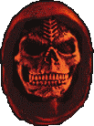
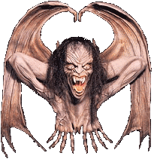
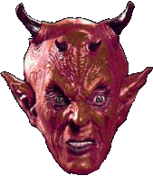
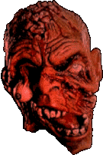
Costumes
People thought that they would encounter ghosts if they left their homes…

Slide 6
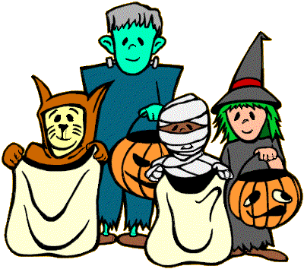
So they wore costumes.
This way, the ghosts couldn’t recognize them!

Slide 7
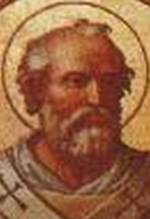
The Christian Influence
As the influence of Christianity spread into Celtic lands, in the 7th century, Pope Boniface IV introduced All Saints' Day, a time to honor saints and martyrs, to replace the Pagan festival of Samhain. It was observed on May 13th.

Slide 8
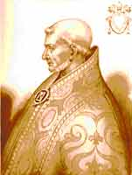
A change of date
In 834, Pope Gregory III moved All Saint's Day from May 13th to Nov. 1st. Oct. 31st thus became All Hallows' Eve ('hallow' means 'saint').

Slide 9
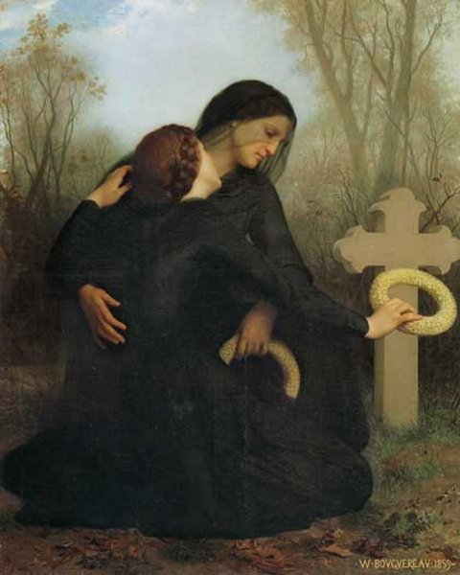
All Souls Day
November 2nd, called All Souls Day, is the day set apart in the Roman Catholic Church for the commemoration of the dead.

Slide 10
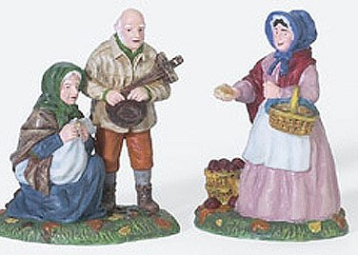
Trick-or-treating began with the poor in the 15th century…
During the All Souls Day festival in England, poor people would beg for “soul cakes,” made out of square pieces of bread with currants
Families would give soul cakes in return for a promise to pray for the family’s relatives

Slide 11
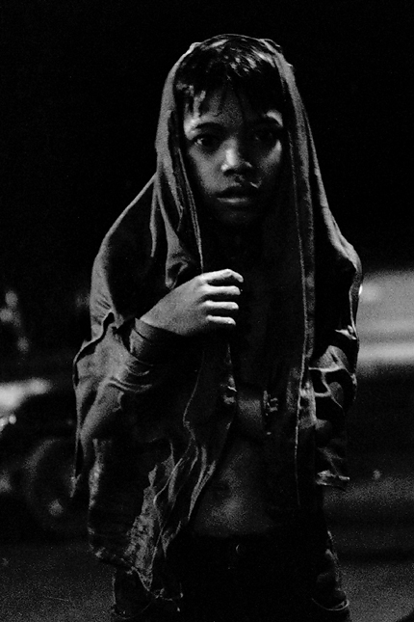
then children…
The practice, which was referred to as "going a-souling" was eventually taken up by children who would visit the houses in their neighborhood and be given ale, food, and money.

Slide 12
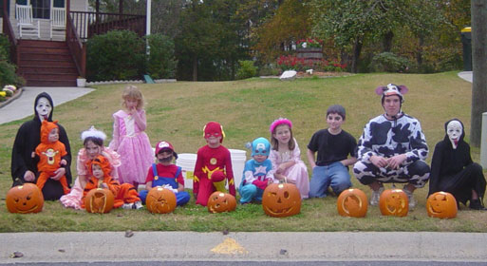
Today:
Children still go from house-to-house, but instead of ale, food and money, they get candy.

Slide 13
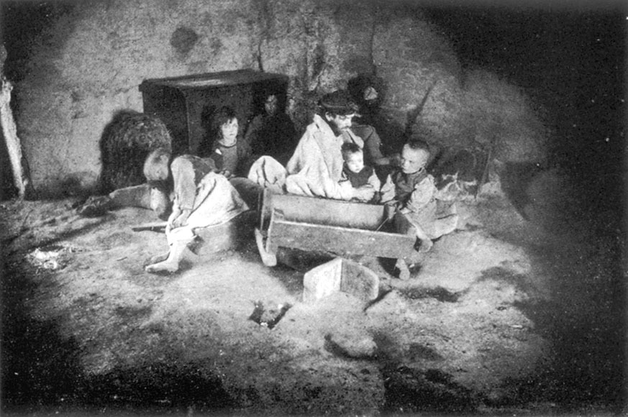
With Irish Immigration…
In 1848, millions of Irish emigrants poured into America as a result of the potato famine. They brought with them their traditions of Halloween.

Slide 14
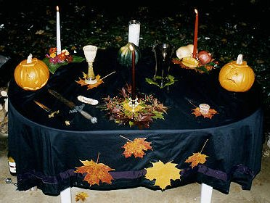
Halloween came to America.
They called Halloween Oidche Shamhna (`Night of Samhain'), as their ancestors had, and kept the traditional observances.

Slide 15
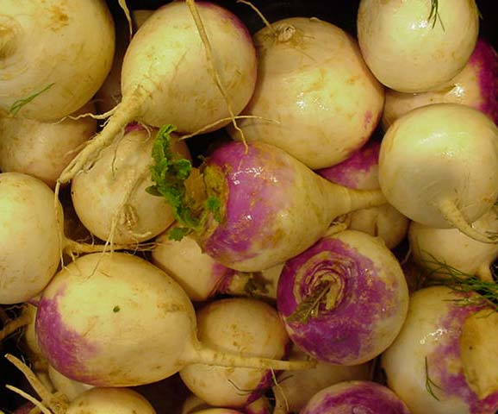
The Jack-O-Lantern
The Irish used to carry turnips with candles in them to light their way at night and to scare away ghosts..

Slide 16
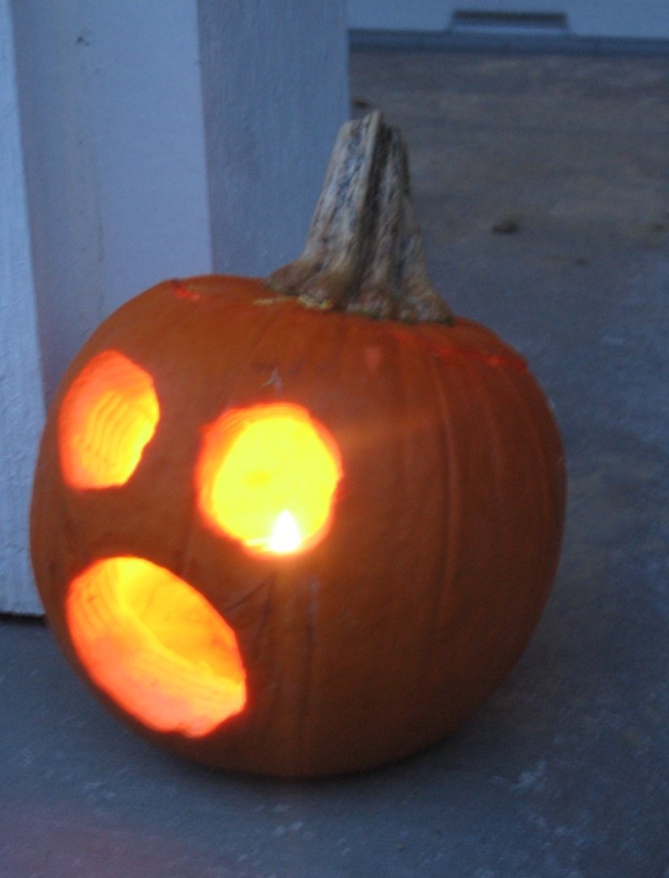
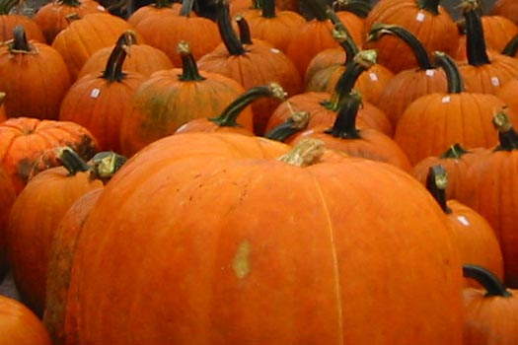
When they arrived in America they found that pumpkins were both plentiful and easier to carve than turnips.

Slide 17
Now, Jack-O-Lanterns are used for decorating people’s homes.

Slide 18
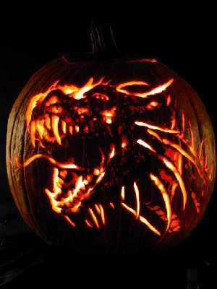
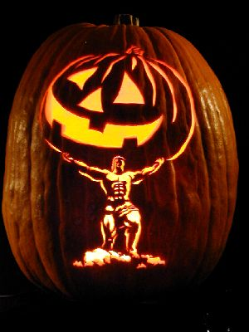
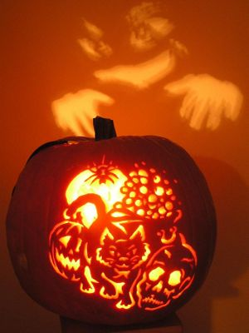
People have recently started carving less traditional Jack-O-Lanterns

Slide 19
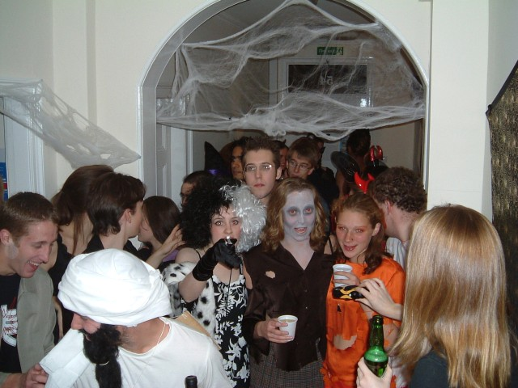
Today people go to parties…

Slide 20
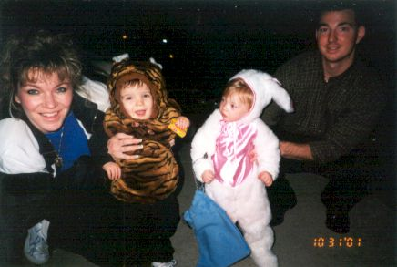
Take their kids trick-or-treating.…

Slide 21
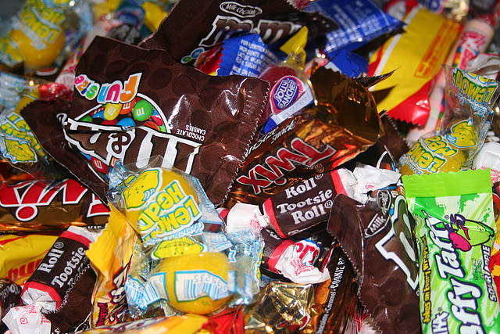
And eat lots of candy!

Slide 22
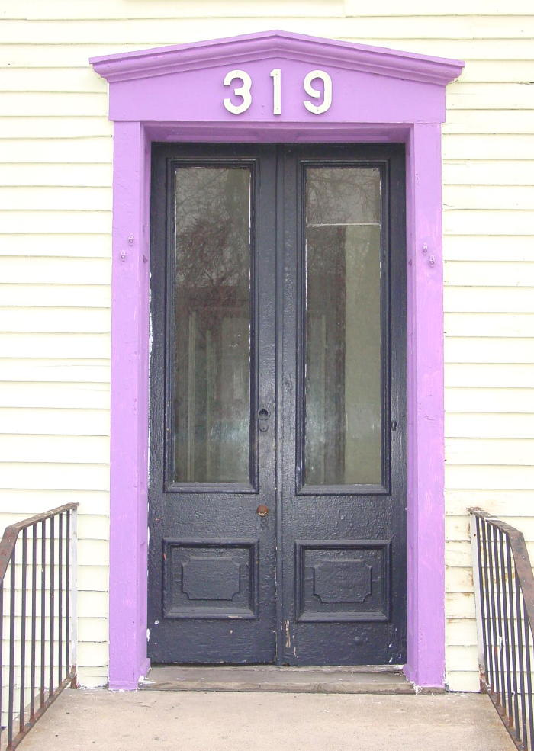
If you don’t give candy to a trick-or-treater…

Slide 23
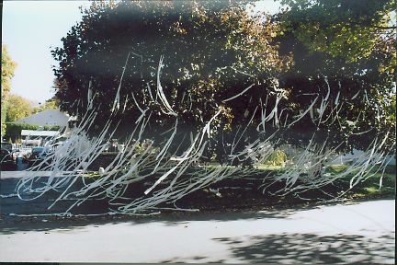
This could happen to you!

Slide 24
Bibliography
www.wilstar.com/holidays/hallown.htm
www.historychannel.com/halloween
http://en.wikipedia.org/wiki/All_Souls_Day#Pagan_roots
www.fni.com/heritage/oct97/historyhall

Slide 25
The End
Happy Halloween!

Slide 26
This powerpoint was kindly donated to www.worldofteaching.com
http://www.worldofteaching.com is home to over a thousand powerpoints submitted by teachers. This is a completely free site and requires no registration. Please visit and I hope it will help in your teaching.

