Slide 1
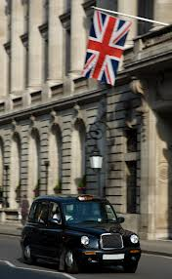
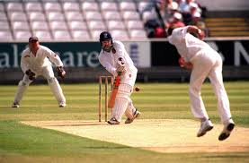
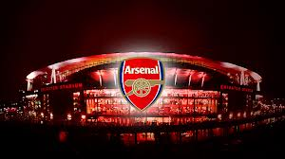
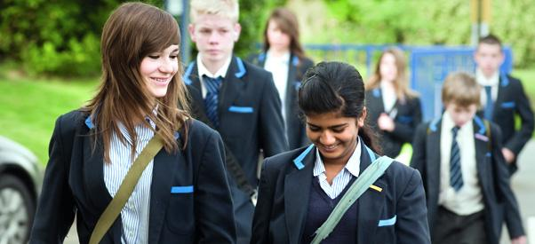
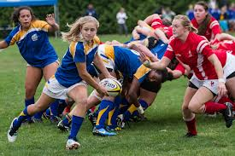
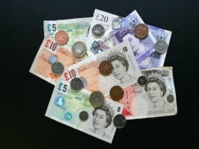
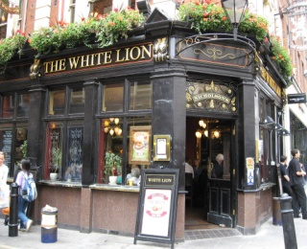
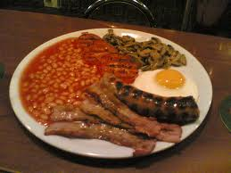
LIFE IN GREAT BRITAIN

Slide 2

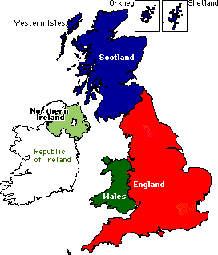




The flag of the UK
Nickname: Union Jack

Slide 3
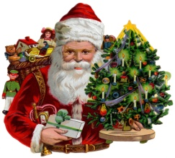
A typical school year in Britain
Starts at the beginning of September
School year is divided into three terms
School holidays:
The Christmas holidays – two weeks
The Easter holidays – two weeks
The summer holidays – six weeks
Short holidays in October, February and May – they usually last for one week

Slide 4
A typical school day
The school day usually starts at 8.45 and it finishes at around 3.30.
There is one small break in the morning (20 minutes) and a longer lunch break (1 hour )

Slide 5
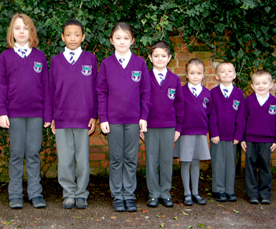
Children usually wear school uniforms.

Slide 6
Children start primary school at 5
Primary school is from 1st to 6th grade
After the 6th grade children go to secondary school (11 – 16)
In secondary school children are divided into groups according to their abilities
Children write SAT tests at the ages of 7, 11 and 14

Slide 7
Subjects:
Geography
Histroy
Art and design
English (4 lessons per week)
French
Maths (4 lessons per week)
Citizenship
Music
Design and technology
Biology
PE
Games (double period per week)
ICT
RE
Physics
Chemistry
Lessons last 60 minutes!

Slide 8
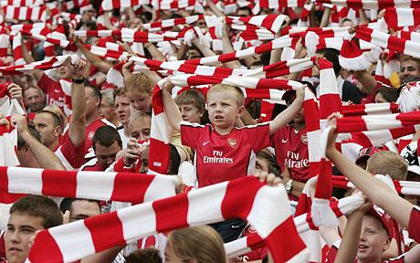

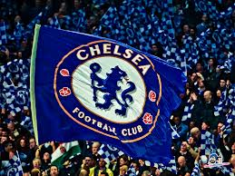
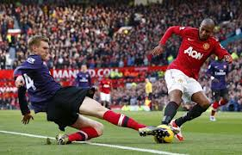
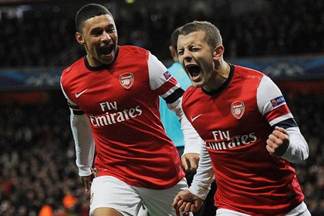
Sports in Britain:
Football
Football is the most popular sport in the UK.
The big London clubs are: Arsenal, Tottenham, Chelsea, Fulham and West Ham United.
Most towns have a football club.
Games are on Saturday and Sunday afternoons and evenings.

Slide 9
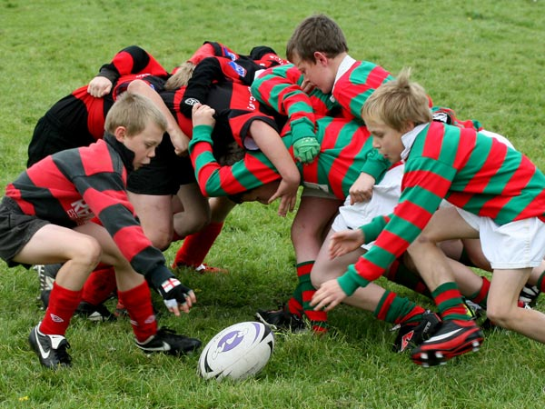
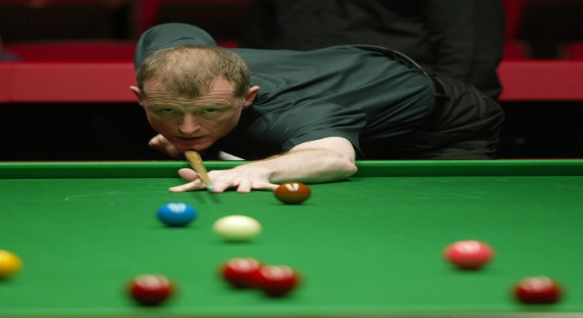
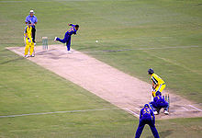
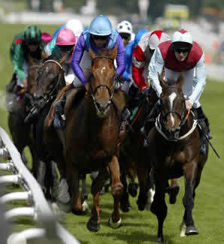
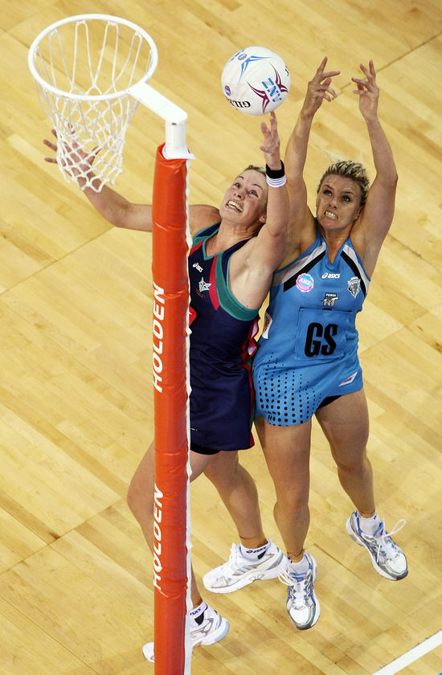
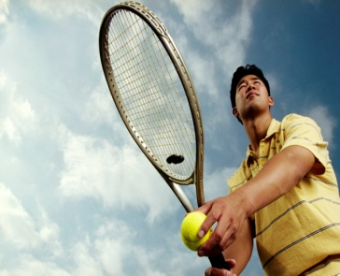
OTHER POPULAR SPORTS:
RUGBY
CRICKET
SNOOKER
NETBALL

Slide 10
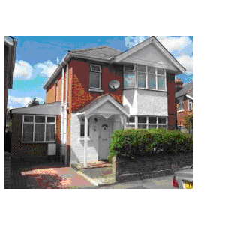
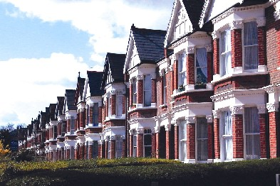
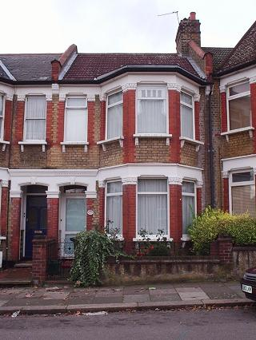
Typical houses:

Slide 11
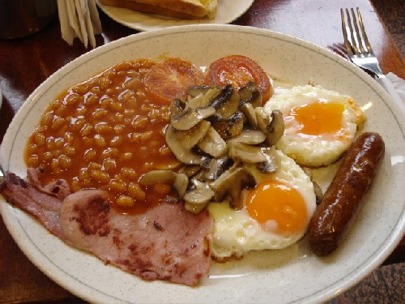
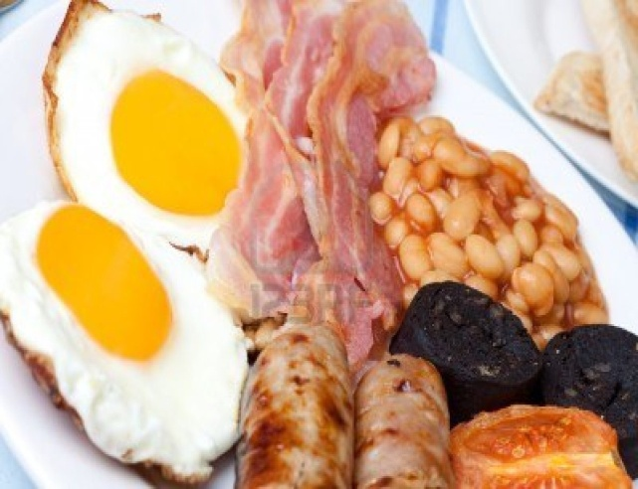
FOOD AND DRINKS
TRADITIONAL ENGLISH BREAKFAST:
bacon, eggs, sausages, tomatoes, mushrooms, baked beans, black pudding and fried bread with lots of tea or coffee.
When you have a breakfast like that in the morning, you do not need to eat much for lunch.
People don’t usually have time to prepare traditional English breakfast every day ☺

Slide 12
Breakfast – usually between 7 and 8 o’clock
toast, jam, honey or marmelade, cereal, fruit, yoghurt, pancakes
Lunch – usually between 12 o’clock and 2 o’clock
A light soup, sandwich and / or salad
Children have their lunch at school.

Slide 13
Dinner (between 6 and 7 o’clock in the evening)
The most important meal of the day.
Meat or fish with potatoes and vegetables
Pasta, spaghetti, lasagne...
Dessert

Slide 14
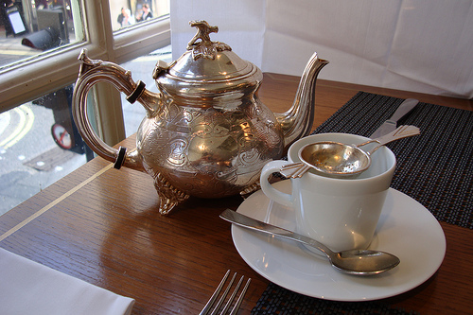
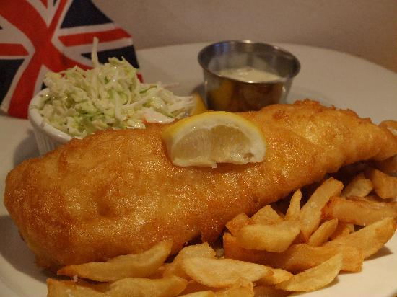
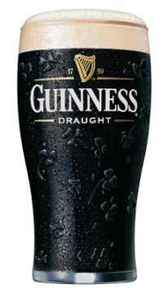
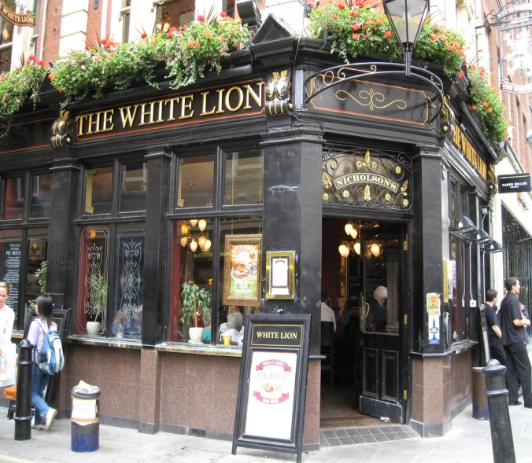
FISH AND CHIPS
TEA with milk
BEER
A typical English pub is a good place for light lunch and a drink.

Slide 15

Work
The Working Day
The usual working day starts at 9am and finishes by 5pm.
Most people work a five-day week.

Slide 16
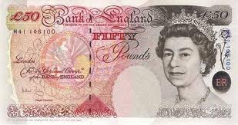
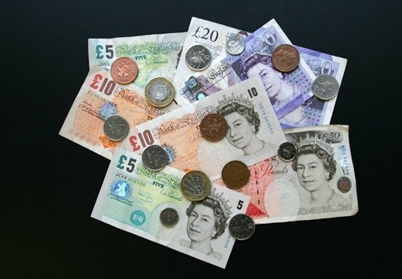
Money
Pounds and pence are the British money:

Slide 17
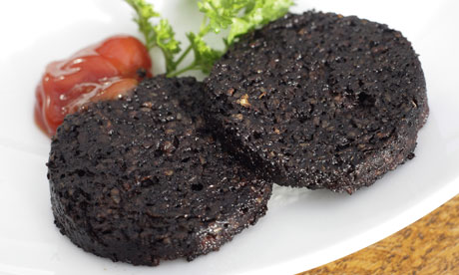

What is on the pictures?

Slide 18
What’s missing?
1. School day usually starts at _____ and finishes at ________.
2. Children __________ (wear / don’t wear) school uniforms in the UK.
3. Secondary school starts in the ___th grade.
4. Some popular sports in the UK are: ________
5. ______ is the most important meal of the day.
6. The English drink tea with ____________.
7. The British money are _________and _____.
8. Traditional English breakfast consists of: _________________________________

Slide 19

Sources:
Breka Olinka, Way to go 3, Školska knjiga, Zagreb
Tom Hutcinson, New Project 1, OUP
John Escott, Factfiles: England, OUP
www.projectbritain.com (17 Jan 2013)
L. K. 2013.

