Slide 1
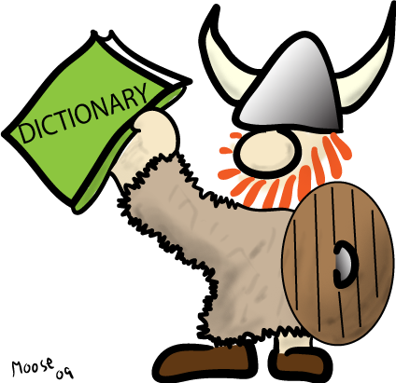
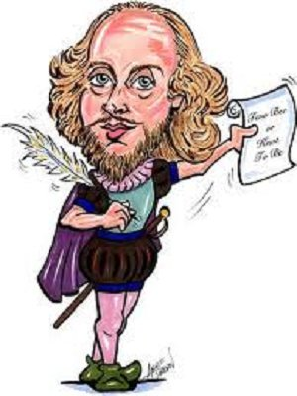
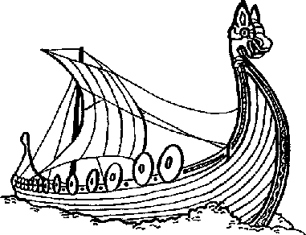
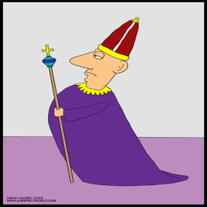
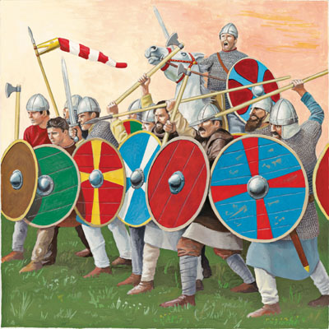
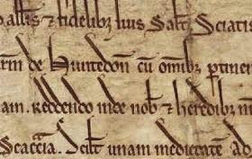
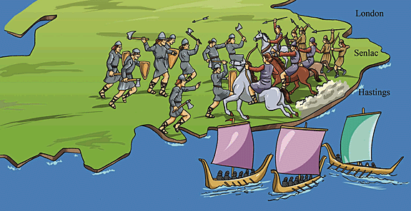
The Story of English

Slide 2
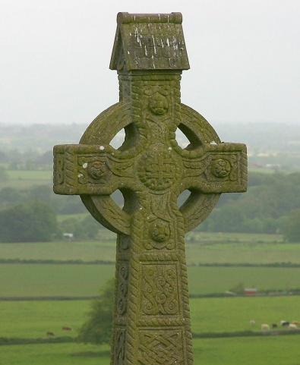
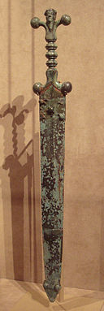
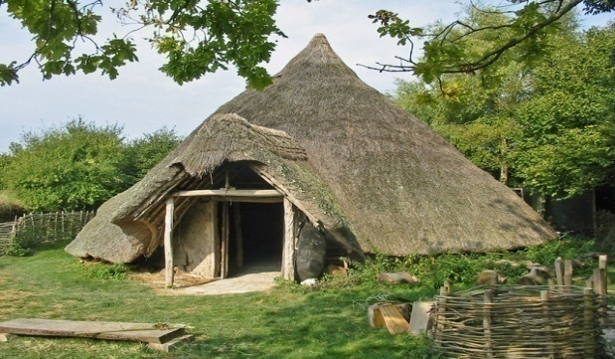
THE CELTS
From around 750 BC to 12 BC, the Celts were the most powerful people in central and northern Europe.
Celts are usually divided into the three groups:
warriors
Druids , the religious leaders;
farmers
No one called them Celts – this is the modern name invented in the 18th century!

Slide 3
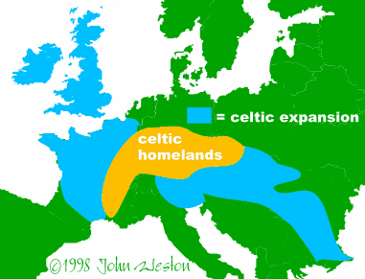
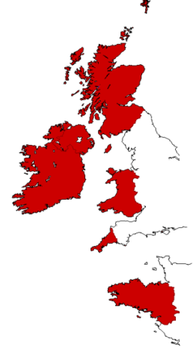
CELTIC languages
CELTIC languages were widely spoken across the Europe
Today they are spoken by less than 2 million of people altogether
Irish Gaelic:
DUBLIN – Bhaile Atha Clitah
IRELAND – Eirinn

Slide 4
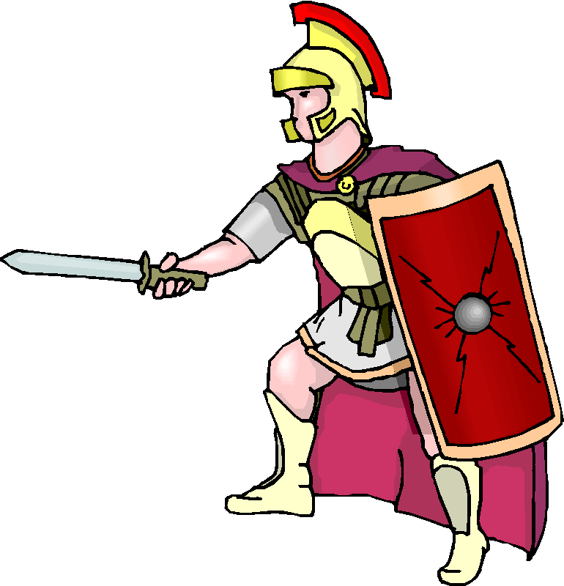
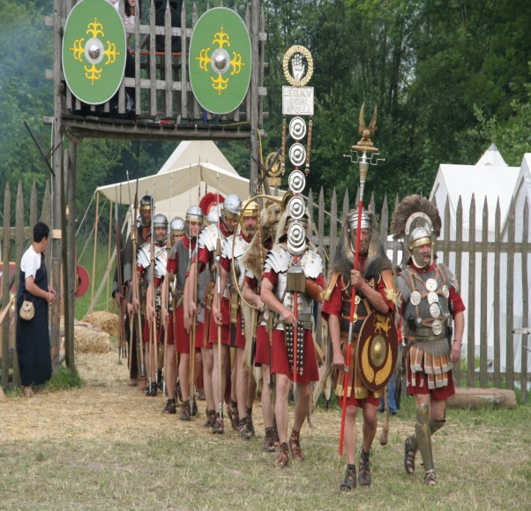
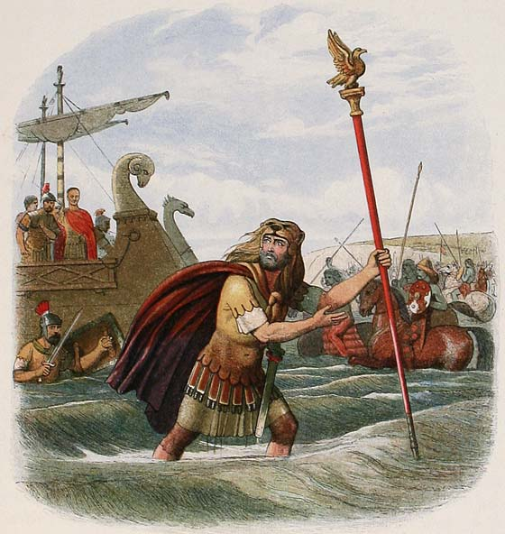
THE ROMANS
43 BC - Roman occupation of Britain
Romans established their colony called BRITANNIA
Celtic tribes were Romanized
The Celts from Britannia were known as Britons

Slide 5
THE ANGLES, SAXONS and JUTES
Came to Britain in the 5th century (after the Romans left)
They came across the North Sea in wooden boats from what is now Germany, Denmark and the Netherlands.
They were looking for new places to farm

Slide 6
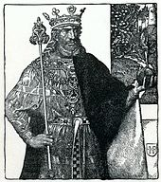
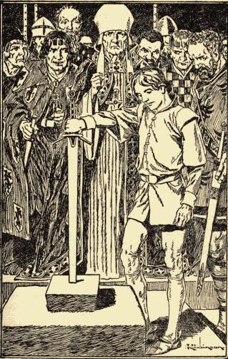
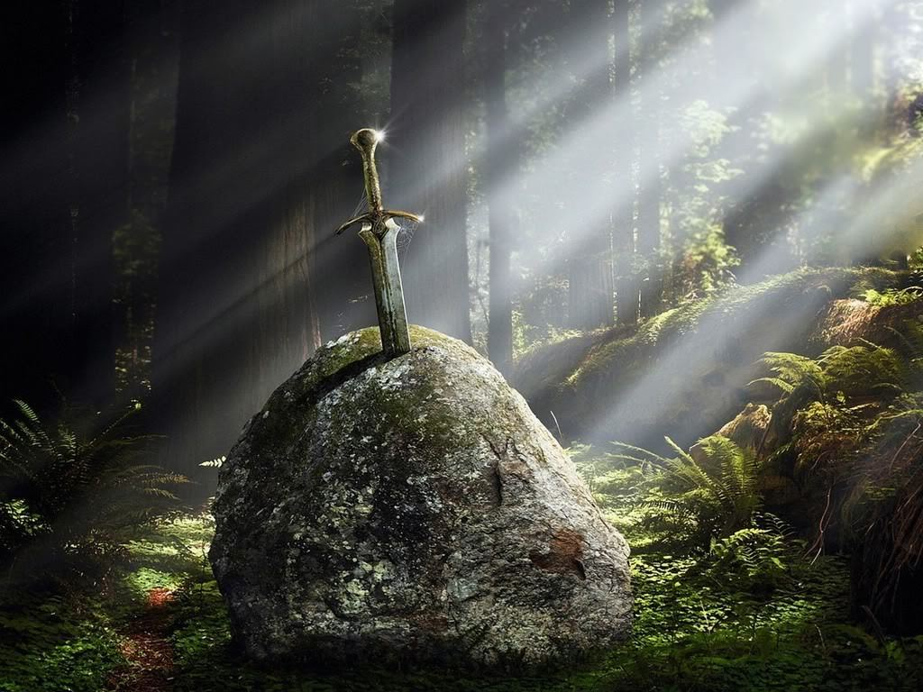
King Arthur tried to fight them off, but they soon settled and stayed in what we now call England (meaning 'Angle Land').

Slide 7
Their languages slowly turned into the oldest form of English called Old English
Many words in English have an Anglo-Saxon origin:
Everyday objects and things: milk, finger, horse
Days of the week: Monday, Tuesday...
Body parts: head, heart, arms...
Names for family members: son, daughter...

Slide 8
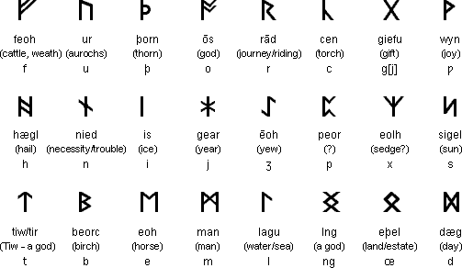
They used the futhork alphabet.
The letters were called runes.
Runes had lots of straight lines, because that made the runes easier to carve them onto wood, stone or metal.

Slide 9
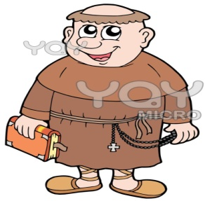
CHRISTIANITY
Anglo-Saxons were pagans
conversion to Christianity began in 597
a lot of words came into English from Latin
candle, rose, bishop
LATIN was the language used by Church
WRITING came with Christianity.
Futhork was replaced by LATIN script.

Slide 10
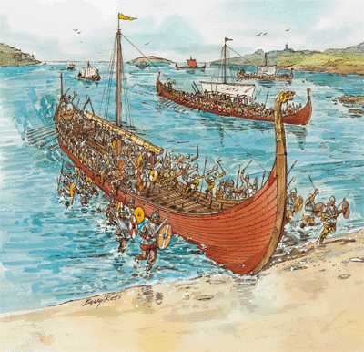
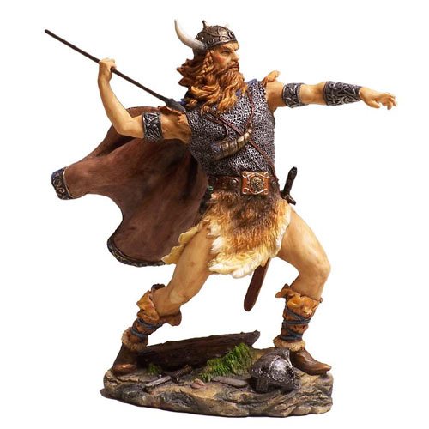
THE VIKINGS vikingr – “the one who came from fjords” (Danes, Swedes, Norwegians)
They came from Scandinavia
Their language was called OLD NORSE
A lot of words in English beginnig with sk- came from Old Norse: sky, skin, skirt

Slide 11
Here are some other words Vikings brought to English:
Gun – from gunn (“war, battle”)
Hell – from Hel, the ruler of the Underworld in Norse mythology.
Hit – from hitta (“find”).
Husband – from husbondi (“master of the house”).
Knife – from kniv, kvifr. Any word starting with kn- is probably from old Norse.
Town – from tun, referring to the open space between buildings.
Ugly – from uggligr (“dreadful”).

Slide 12
THE NORMANS
In 1066 the Normans started rulling England
They came from the northern part of France

Slide 13
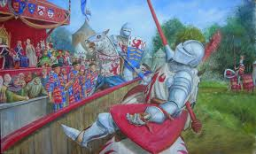
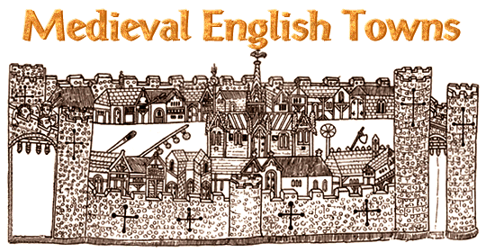
FRENCH became the language of the court, the government, the church, the army and the law
All the educated people who wanted to be successful had to speak LATIN or NORMAN FRENCH
government, honour, music, colour, costume,
country, people, parliament, nation,
crown, prince, noble, sir, madam...

Slide 14
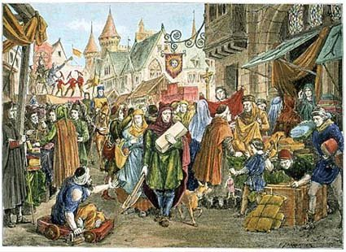
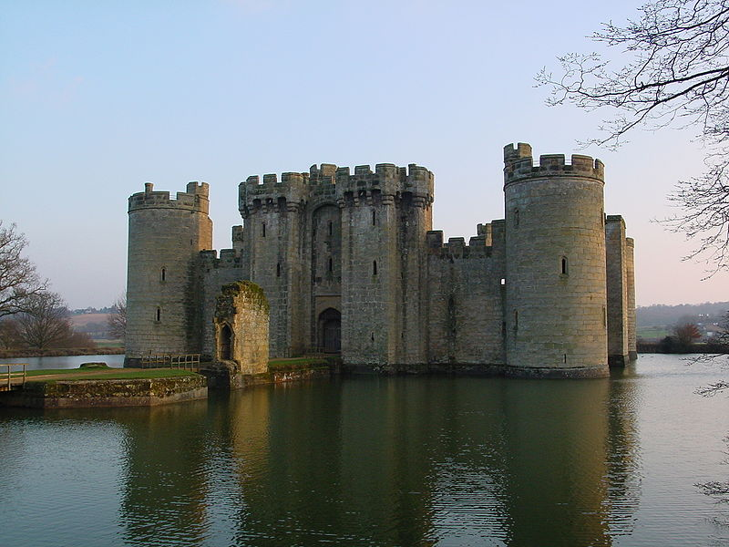
Around the 14th century English again became spoken generally
The English was widely spoken but the grammar and rules of English were not standardized

Slide 15
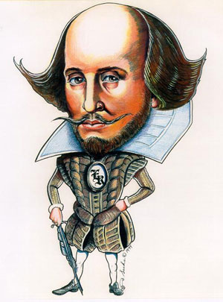
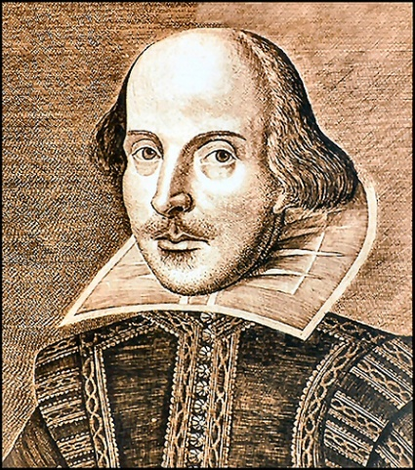
SHAKESPEARE
in the late 17th and 18th centuries Shakespeare’s plays became very popular
his plays helped the standardization of the language
Shakespeare also “invented” a lot o words and phrases, for example:
Bump, fortune-teller, gloomy, to gossip, successful, addiction

Slide 16
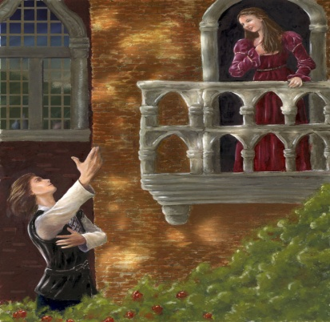
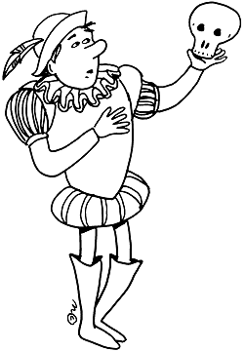
Phrases:
Wild-goose chase
Love is blind
A horse, a horse! My kingdom for a horse!
Good riddance
Crack of doom
All's well that ends well
All that glitters is not gold
To be or not to be...

Slide 17
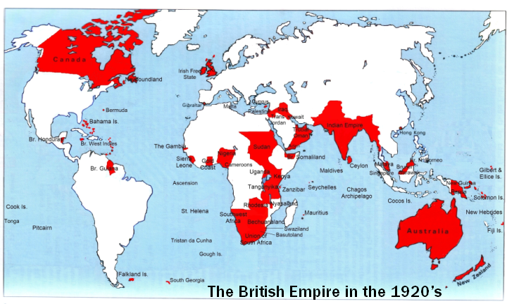
The expansion of the British Empire

Slide 18
Modern English
There are many dialects of English spoken throughout the world:
American English, Australian English,
British English, Canadian English, Caribbean English, Hiberno-English (Irish English),
Indo-Pakistani English, Nigerian English,
New Zealand English,
Philippine English,
Singaporean English,
South African English
There are over 1 billion speakers of English
There are around million words in English
Three most commonly used words: THE, OF, TO

Slide 20
Sources:
Way to go 5, Školska knjiga, Zagreb 2009.
http://history.parkfieldict.co.uk
http://www.irishdictionary.ie
http://www.omniglot.com
http://www.woodlands-junior.kent.sch.uk
http://en.wikipedia.org
www.pathguy.com/shakeswo.htm
L.K., 2012

