Slide 1
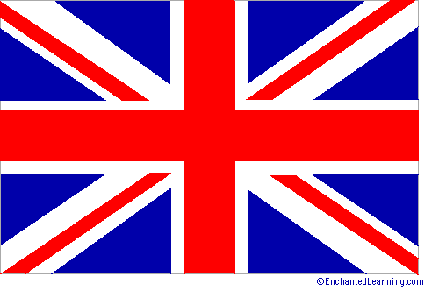
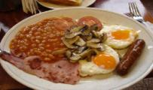
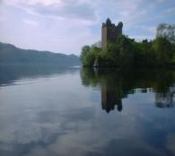
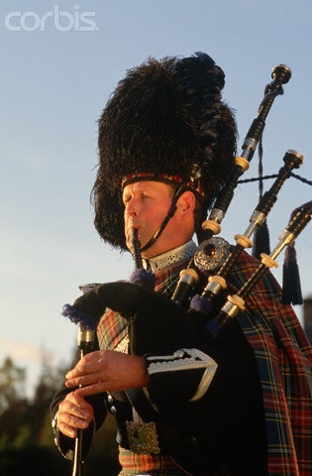
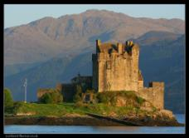
THE UNITED KINGDOM OF GREAT BRITAIN AND NORTHERN IRELAND

Slide 2
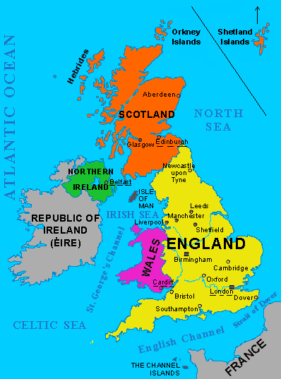
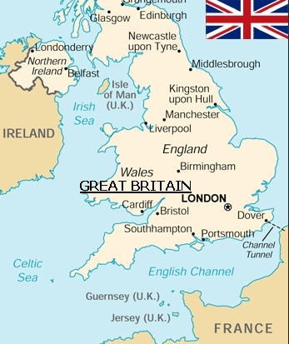

Slide 3
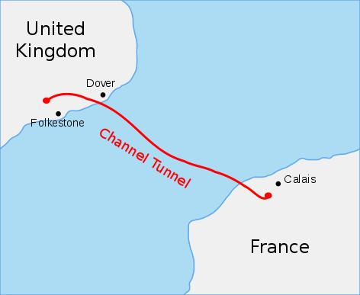
The UK and France are connected with Channel Tunnel
- the Chunnel.
The Chunnel was opened on 6 May 1994.
Length: 50,45 km

Slide 4
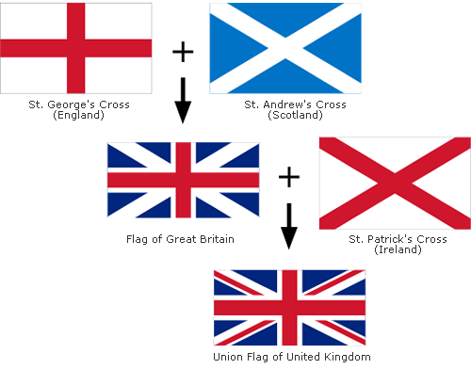
This is the official flag of the country since 1801.
Nickname: Union Jack

Slide 5
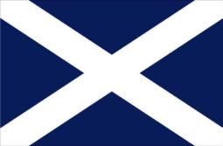
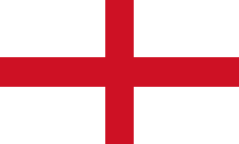
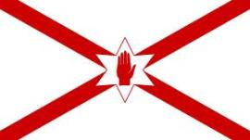
FLAGS of Scotland, Wales, England and Northern Ireland

Slide 6
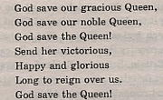
The national anthem
…is the oldest in the world, established in 1745 and based on a song of the 17 th century.
http://www.youtube.com/watch?feature=player_detailpage&v=AwziS2aE6Ww

Slide 7
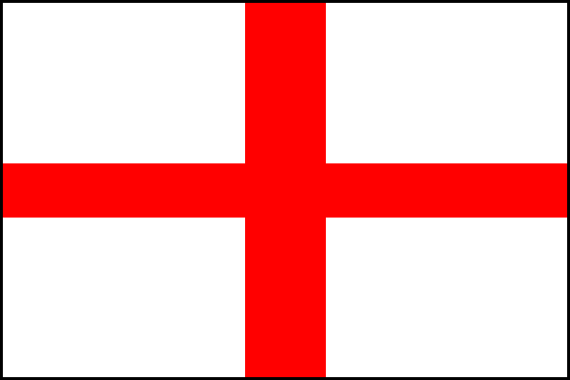
ENGLAND
The name "England" comes from the old English word Englaland, which means "land of the Angles".
Colour of England is white
Plant: rose
Patron saint: St George (celebrated on 23 April)
The flag
Coat of Arms (grb)

Slide 8
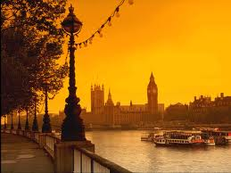
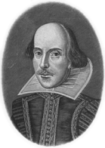
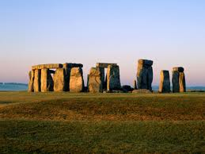
ENGLAND

Slide 9
SCOTLAND
Colour of Scotland is blue
Plant: thistle
Patron Saint: St Andrew
Capital: Edinburgh
thistle
Celebrated on 30 November
The Flag

Slide 10
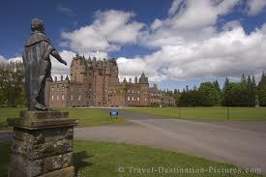
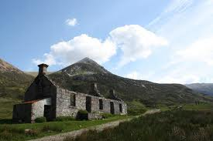
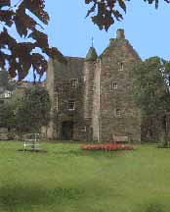
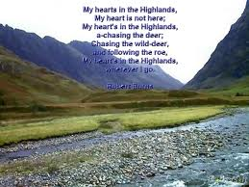
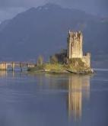
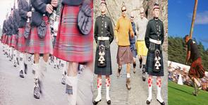
SCOTLAND Highlands, castles, kilts and Nessie

Slide 11
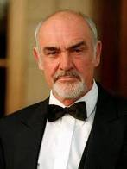
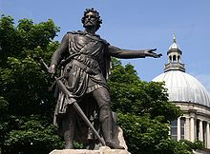
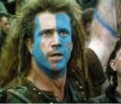
Famous Scots
Bell- the inventor of the telephone
J. K. Rowling – the author of “Harry Potter”
Alexander Fleming- penicilin
Sean Connery, the actor
William Wallace “Braveheart

Slide 12
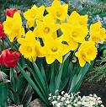
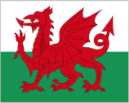
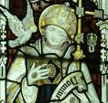
WALES
Colour of Wales: RED
Plants: leek, daffodil
Capital: Cardiff
Patron Saint: St David
daffodils
leeks
The flag
Celebrated on 1 March

Slide 13
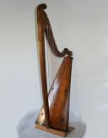
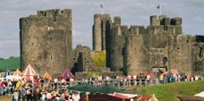
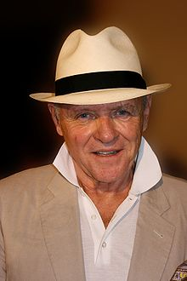
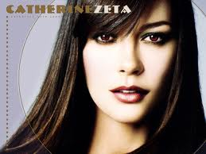
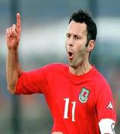
Wales
The smallest part of GB (Great Britain)
Wales is the land of music

Slide 14
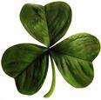
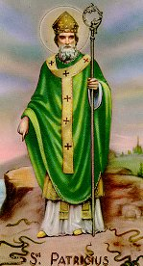
NORTHERN IRELAND - ULSTER
Colour of Ireland is green
Plant: shamrock
Patron Saint: St Patrick
Capital: Belfast
shamrock
The flag
Celebrated on
17 March

Slide 15
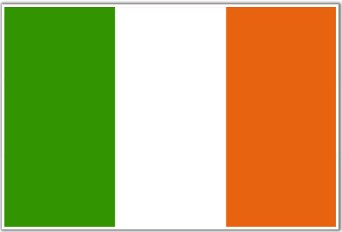
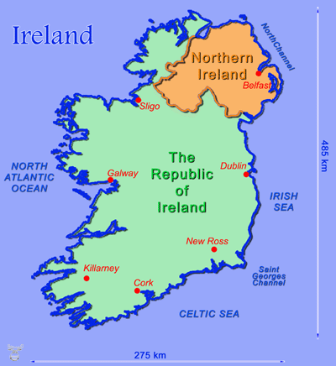
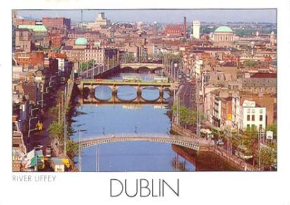
THE REPUBLIC OF IRELAND EIRE
NOT a part of the United Kingdom!

Slide 16
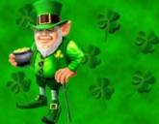
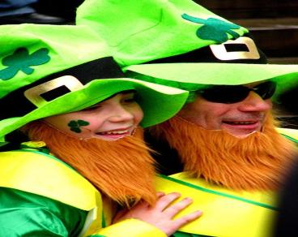
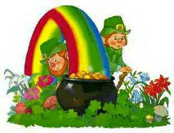
LEPRECHAUNS
"little people" or "fairies" in Irish myths and folk tales
The leprechauns spend all their time busily making shoes, and store away all their coins in a hidden pot of gold at the end of the rainbow.

Slide 17
ROYAL FAMILY

Slide 18
QUEEN ELIZABETH II (1952-) 60 years on the throne
Line of throne succession:
The Prince of Wales (The Prince Charles; b. 1948)
The Duke of Cambridge (Prince William; b. 1982)
Prince Henry ('Harry') of Wales (b. 1984)

Slide 19
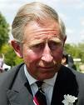
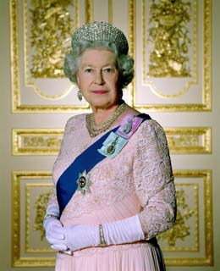
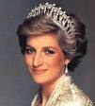
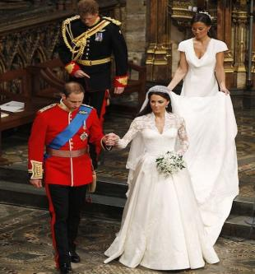
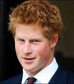

Slide 20
BUCKINGHAM PALACE official residence of British monarch

Slide 21
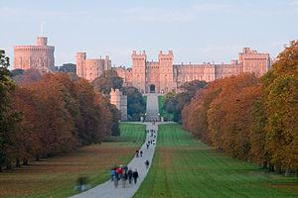
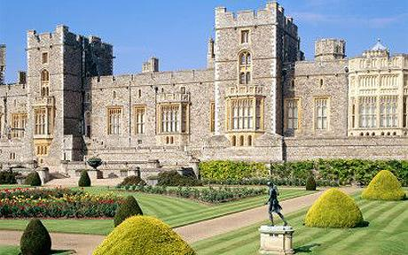
Windsdor Castle
A royal residence and one of the most popular tourist attractions.

Slide 22
BRITISH ROYAL GUARDS

Slide 23
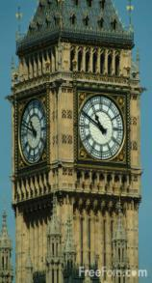
LONDON capital of England (7.355.400 people)
The palace of Westminster or The Houses of Parliament
The Big Ben
The Thames

Slide 24
LONDON EYE

Slide 25
Taxis, phone booths and double-deckers – symbols of London.

Slide 26
BOBBY (english policeman)

Slide 27
The greatest mysteries

Slide 28
STONEHENGE "Who built it and why?"
A prehistoric monument BUILT anywhere from 3000 BC to 2000 BC .
According to some legends, Stonehenge was created by Merlin, the wizard.
There are 80 giant stones standing in a circle.
Is it an ancient chruch where people worshipped gods? A sacred place?
Is it an ancient observatory?

Slide 29
Loch Ness monster (Nessie)

Slide 30
The most famous Britons, Welsh and Scots
Charles Darwin
Rowan Atkinskon
W. Shakespeare
Sir Isaac Newton,
J.K. Rowling
J. R. R. Tolkien
John Lennon
Hugh Laurie
David Beckham
Agatha Christie
James Cook
Lord of the Rings
A famous football player
Dr. House
The Origin of Species
The Beatles
A famous explorer and navigator
Harry Potter
Mr. Bean
Physicist, astronomer, mathematician
A famous crime writer
The Tragedy of Hamlet, Prince of Denmark

Slide 31
Thanks for paying attention!
2012. I. K. ; L.K.

