Slide 1
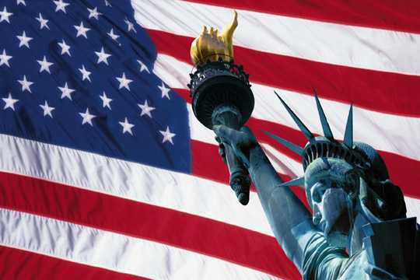
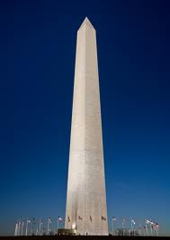
THE USA
WASHINGTON, DC

Slide 2
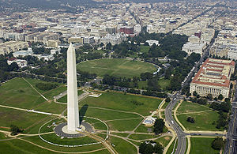
WASHINGTON, DC
is the capital of the United States
DC = District of Columbia
(which means that Washington is not a part of any of the 50 states!)
It’s the 25th largest city in the U.S.
632, 323 inhabitants

Slide 3
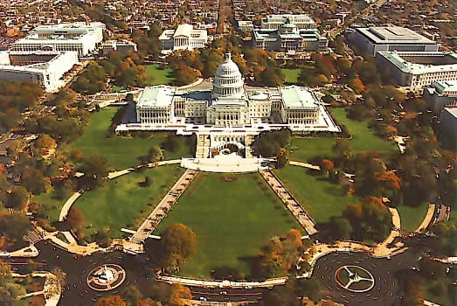
THE CAPITOL
the place where the United States CONGRESS meets and makes laws.

Slide 4
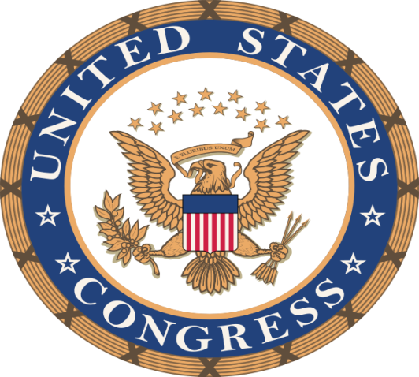
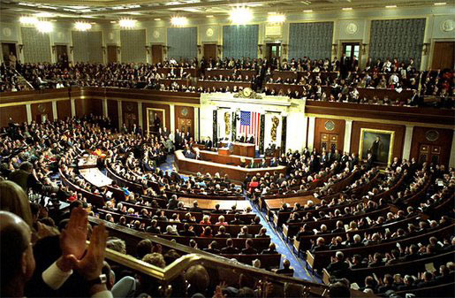
The US Congress consists of 535 members:
100 senators
435 representatives
Two major political parties:
Republicans
Democrats

Slide 5
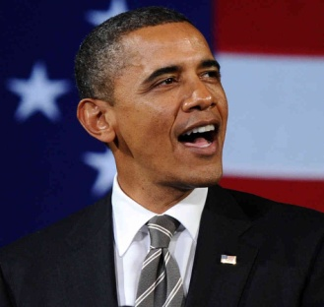
THE WHITE HOUSE
Home of the president of the United States.
The President and his family live and work in the White House.

Slide 6
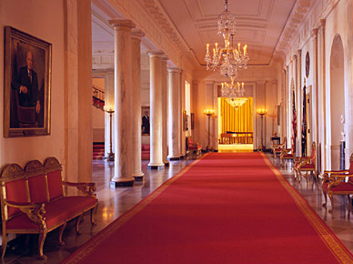
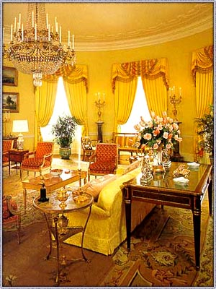
One of the private rooms in the residential part of the White House.
One of the hallways in the White House

Slide 7
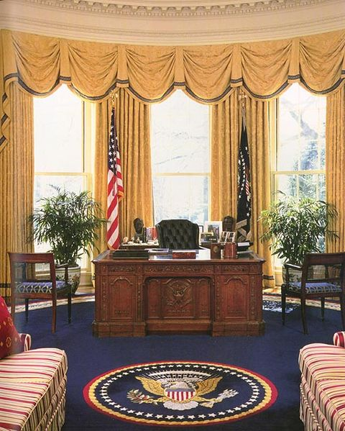
THE OVAL OFFICE
is the official office of the President of the United States.
It is situated in the West Wing of the White House.

Slide 8
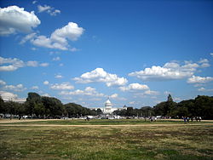
THE MALL
is the green area that connects the Capitol and the Potomac River.
The Mall is famous for many museums and memorials.

Slide 9
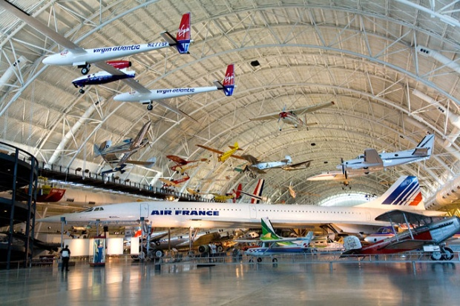
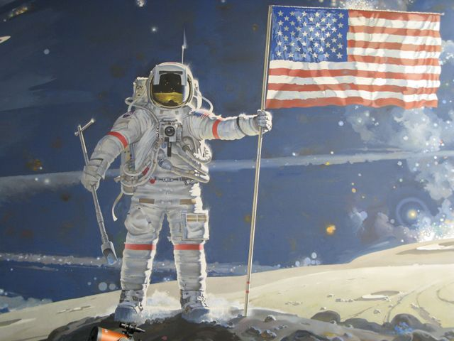
THE NATIONAL AIR AND SPACE MUSEUM
1903 WRIGHT FLYER

Slide 10
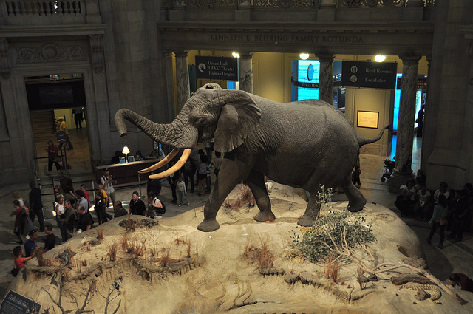
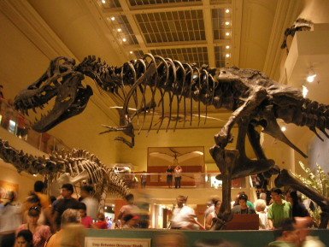
THE MUSEUM OF NATURAL HISTORY

Slide 11
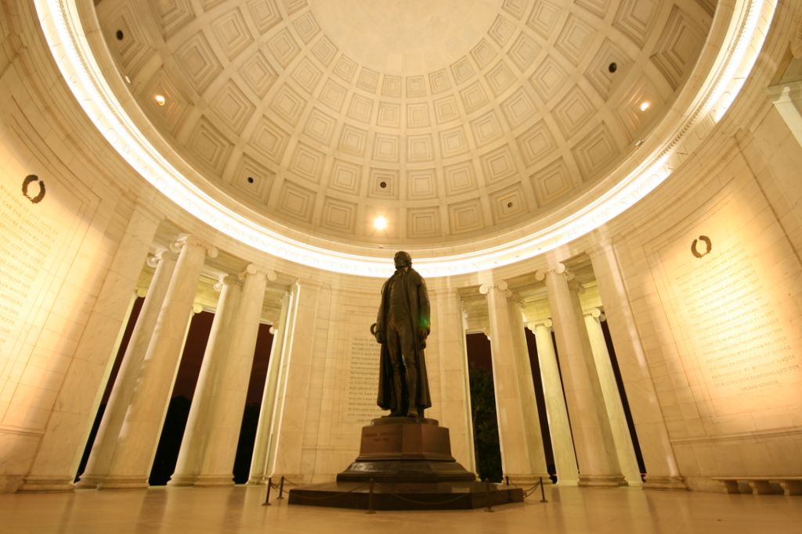
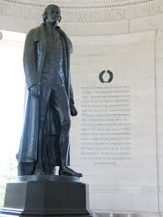
THE JEFFERSON MEMORIAL
Thomas Jefferson was the author of the Declaration of Independece, signed on July 4, 1776.

Slide 12
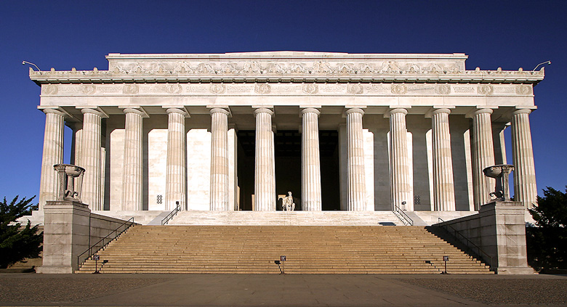
THE LINCOLN MEMORIAL
Abraham Lincoln was also one of the most important historic figures in the USA.
He ended slavery in the USA.
“All men were born equal.” A. Lincoln

Slide 13
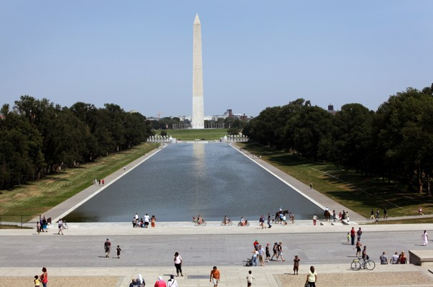
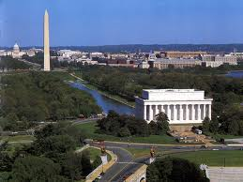
THE WASHINGTON MONUMENT AND THE REFLECTING POOL
A symbol of Washington, DC
dedicated to George Washington, the first president of the US.
170 m high
finished in 1888

Slide 14
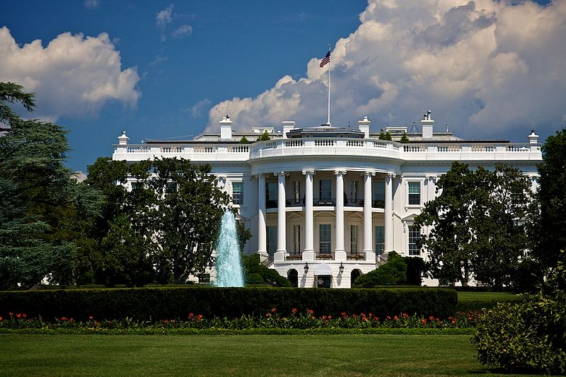
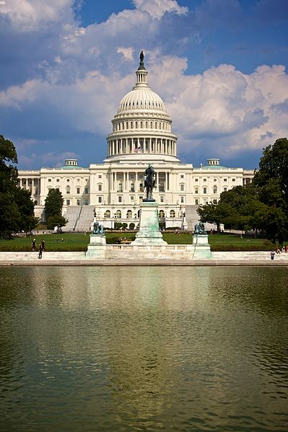
ANSWER THE QUESTIONS:
1. What is on these pictures?
a.
c.
b.
d.

Slide 15
Answers:
a) the Washington Monument
b) The Capitol
c) The White House
d) The Lincoln Memorial

Slide 16
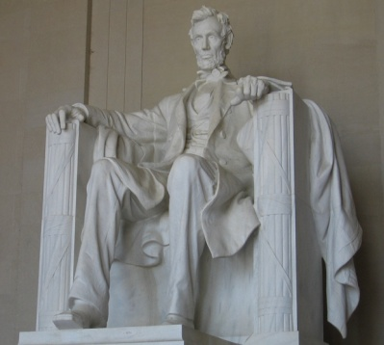
2. Who was George Washington?
Who was Abraham Lincoln?
Who was Thomas Jefferson?

Slide 17
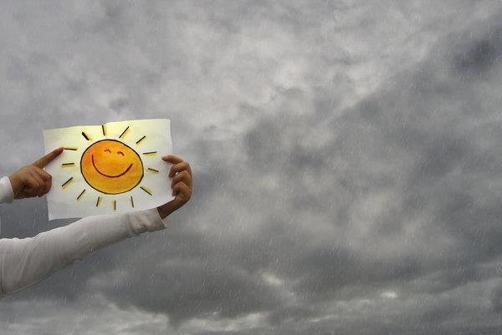
HAVE A NICE DAY!

Slide 18
Sources:
Way to go 4, Školska knjiga, Zagreb
Wikipedia.org
Pictures taken from:
Widipedia.org
L.K. 2013

