Slide 1
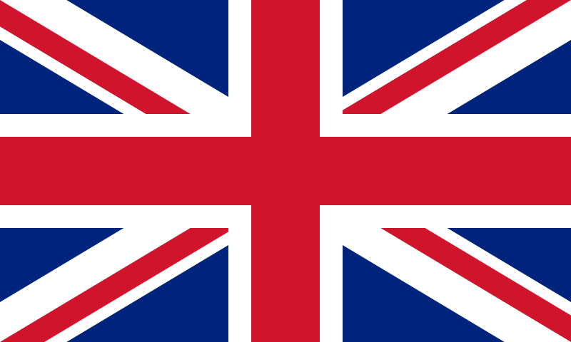
Famous people and sights!

Slide 2
What do we already know?
What is the UK?
What is the GB?
What countries are part of the UK?
Is Republic of Ireland part of the UK?
Who is Elizabeth II?
What is Union Jack?
What is the capital of the UK?

Slide 3
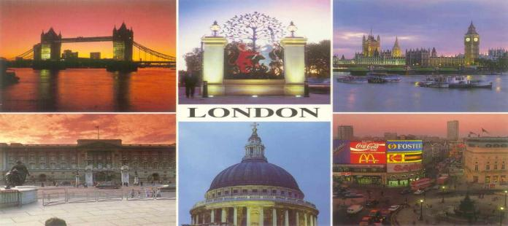
WELCOME
TO LONDON!

Slide 4
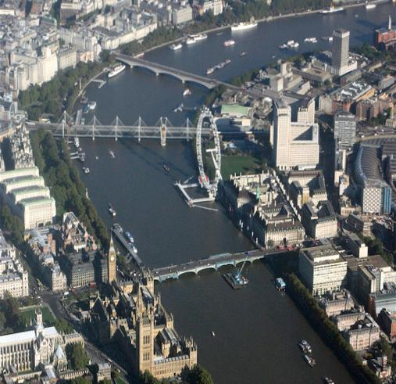
The River Thames
The Thames flows through London.
It is 338 km long.
It is 245 m wide here.
Even big seaships can visit London.

Slide 5
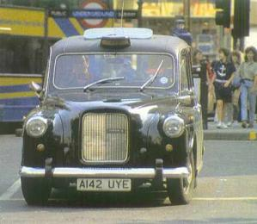
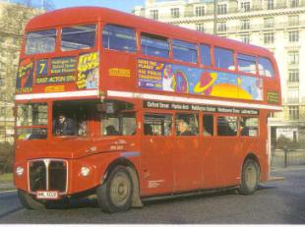
Transport
Taxis in London are old-fashioned black cars.
There are big red buses called double-deckers in London.
People sit upstairs and downstairs on these buses.
Tourists like them very much.

Slide 6
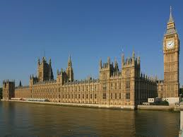
THE HOUSES OF PARLIAMENT
This big palace is the most famous building in the world – the British Parliament.
The building is 280 metres long.
There are more than 1000 rooms in there.
The government meets there.

Slide 7
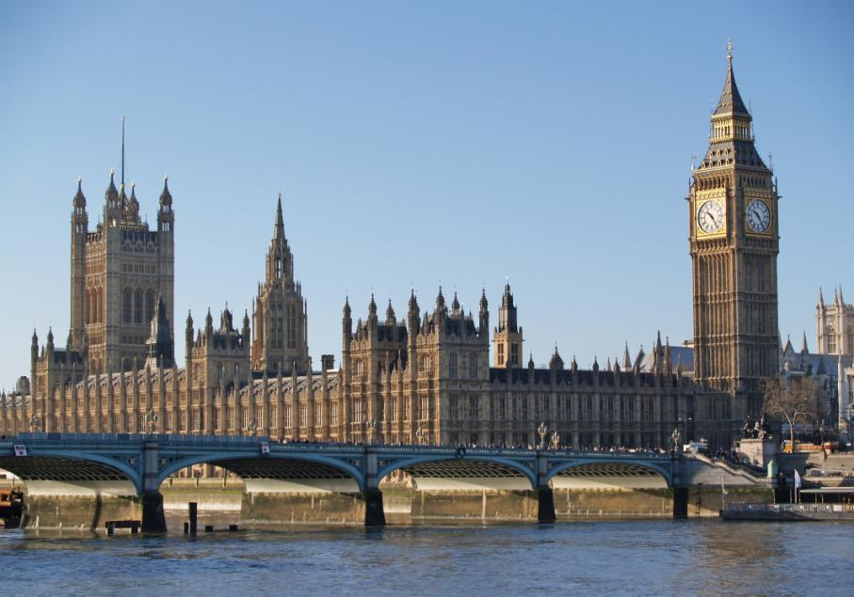

Slide 8
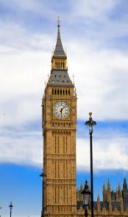
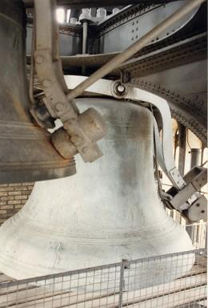
BIG BEN – THE ELIZABETH TOWER
The Elizabeth Tower is the symbol of London. It strikes hours.
Big Ben is a nick name for the biggest bell in the clock tower!

Slide 9
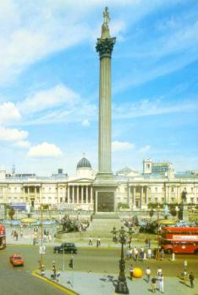
TRAFALGAR SQUARE
There are always a lot of people and pigeons on the square.
Every winter there is a big Christmas tree.
On New Year’s Eve people gather around the tree.
In the middle of the square there is Admiral Nelson’s Column.
There are two fountains on the square.

Slide 10
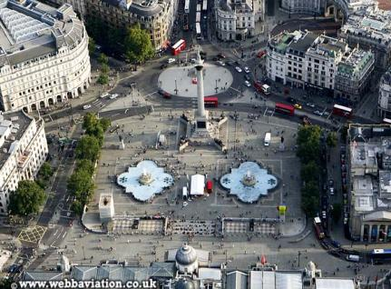
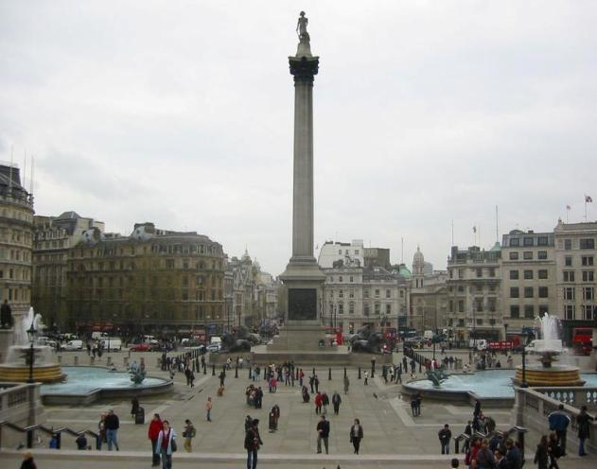

Slide 11
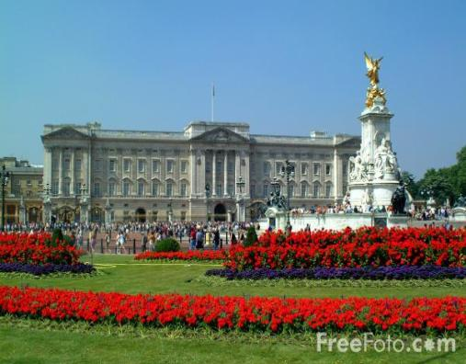
Buckingham Palace
This is the Queen’s home.
It was built in 1703.

Slide 12
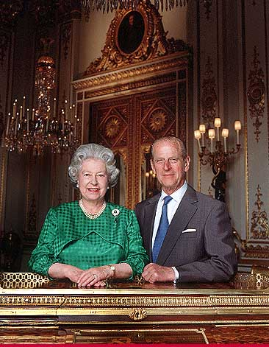
The Queen of Great Britain
The Queen of Great Britain is Elizabeth II. Her husband was Duke of Edinburgh.
Their children: Prince Charles, Princess Anne, Prince Andrew and Prince Edward.

Slide 13
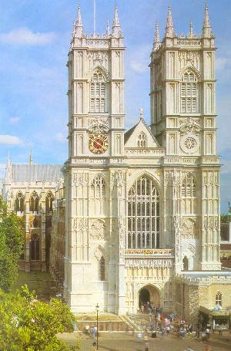
Westminster Abbey
This is the most famous church in the world. All kings and queens have been crowned, married and buried here since 1308.

Slide 14
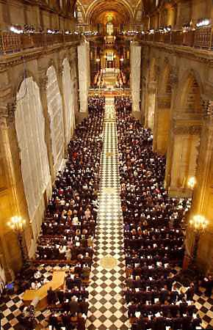
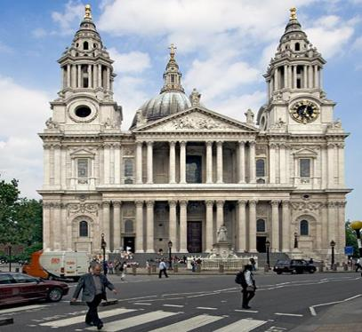
St. PAUL’S CATHEDRAL
The biggest church in London.

Slide 15
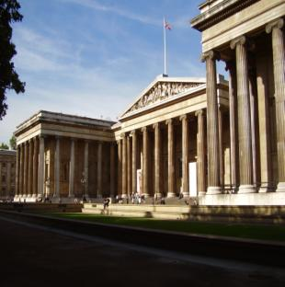
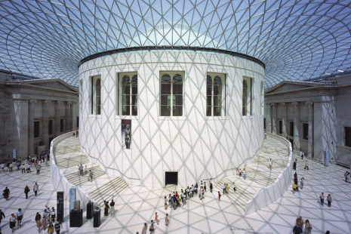
BRITISH MUSEUM
It is famous for its collection of works from Egypt, Greece and ancient Rome.

Slide 16
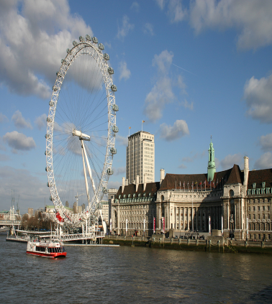
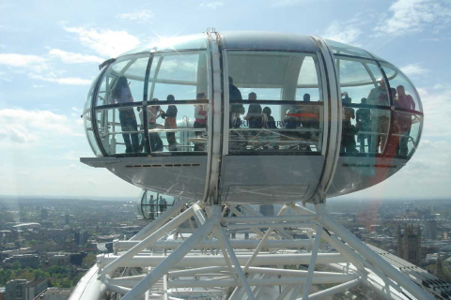
LONDON EYE
From the highest point you can see the whole town. It is on the River Thames.

Slide 17
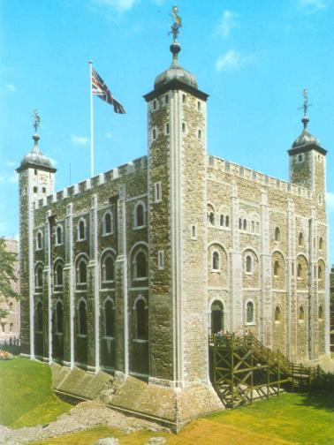
Tower of London
The Tower of London has been a fortress, a palace, a prison ...
Today it is a place where CROWN JEWELS are kept.

Slide 18
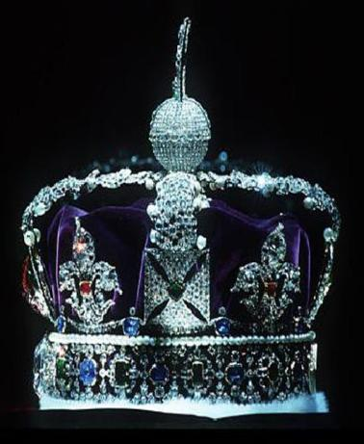
Imperial State Crown
The Tower’s greatest treasure is the Imperial State Crown.
The Imperial State Crown includes many precious gems, including 2,868 diamonds, 273 pearls, 17 sapphires, 11 emeralds, and 5 rubies.

Slide 19
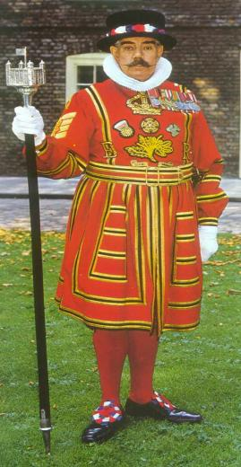
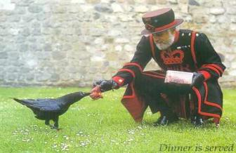
Beefeaters
The guards of the Tower are called Beefeaters.
The legend says that if the ravens leave, the Tower and the country will fall.

Slide 20
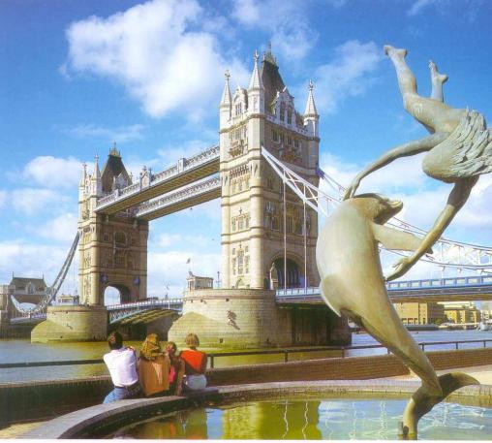
Tower Bridge
The most famous
bridge in London
is a Tower bridge.

Slide 21
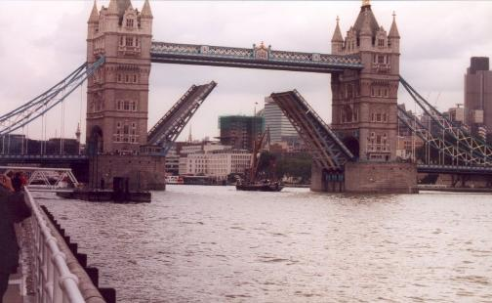
Tower Bridge
Tower Bridge is a bascule-bridge.
The bascules open to let big ships pass through.

Slide 22
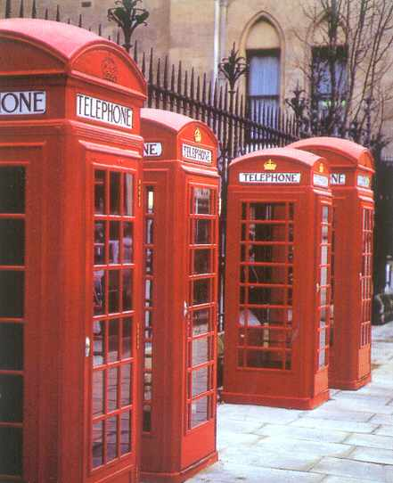
Telephone booths
Famous London phone booths. They are tourist attraction.

Slide 23
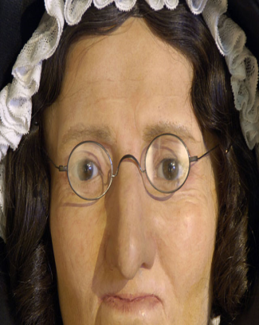
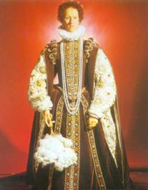
Madame Tussauds Waxmuseum
Here you can see famous people, good and bad, made of wax.
This is Queen Elizabeth I.

Slide 24
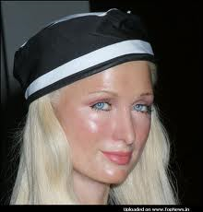
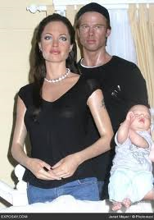
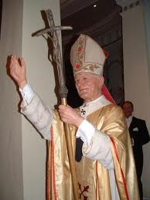
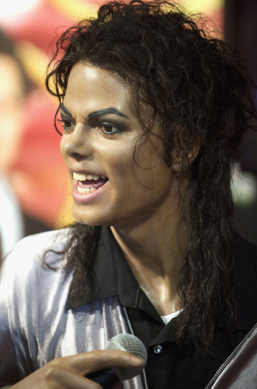
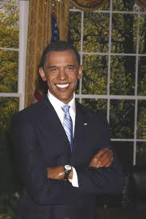

Slide 25
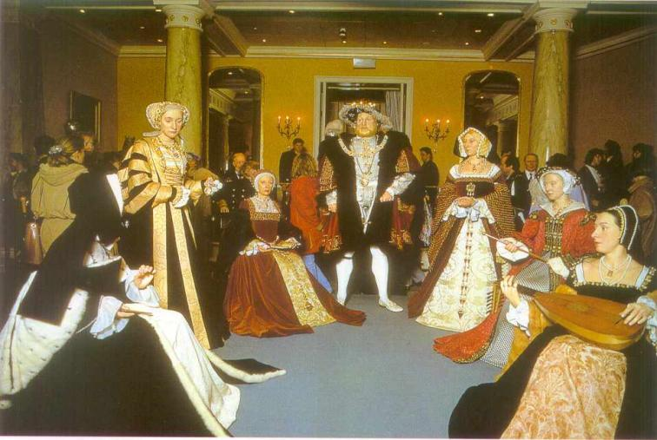
King Henry VIII with his wives

Slide 26
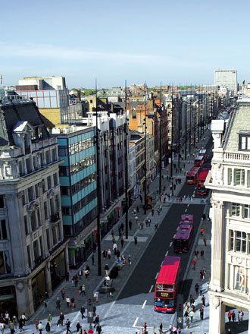
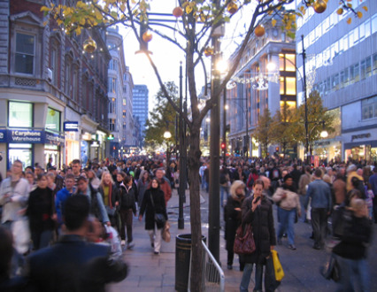
OXFORD STREET

Slide 27
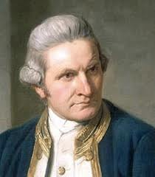
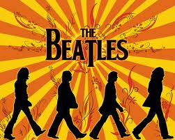
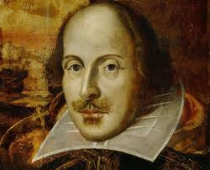
Do you know who they were?
The most famous writer. He wrote Hamlet and Romeo and Juliet, and many other tragedies and comedies.
A famous explorer and seaman who first sailed to Australia.
A famous pop band from Liverpool.

Slide 28
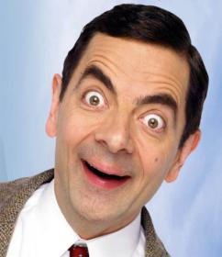
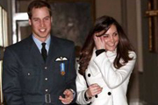
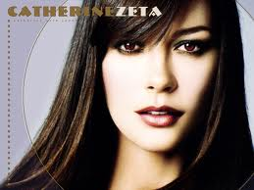
Do you know who they are?

Slide 29
Thank you for watching.
Sources:
Way to go 3, Školska knjiga, Zagreb
Wikipedia.org
L.K. 2013.

