Slide 1
eTwinning Project:
MANFRED
Visiting Schools in Europe

Slide 2
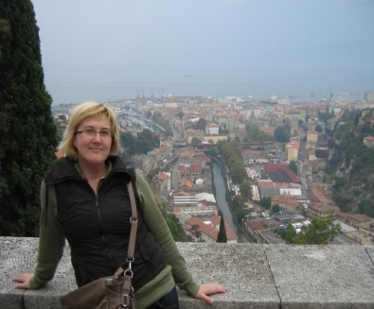
Hello!
My name is Lucija and I’m an English teacher at Vladimir Nazor Primary School.
My pupils and I will be Manfred’s hosts during his stay in Croatia.

Slide 3
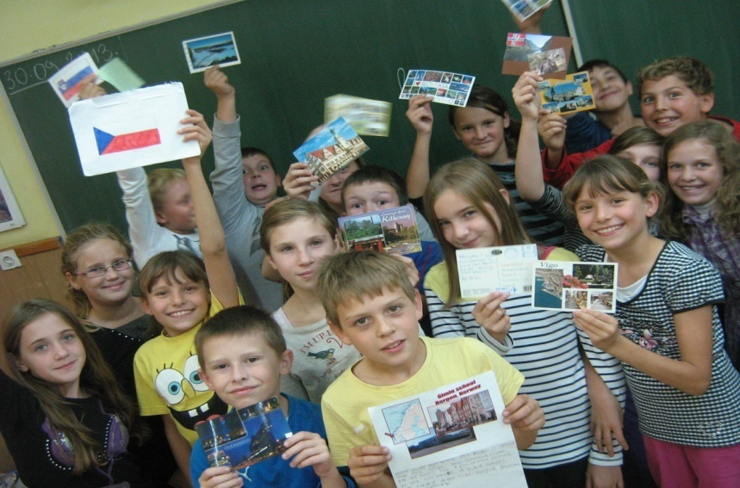
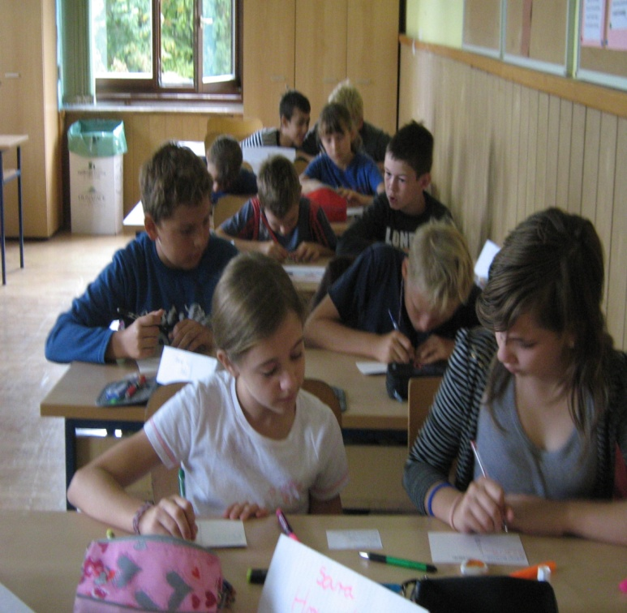
And now, let me introduce manfred’s hosts:
This is form 5.b.
They are eleven and twelve years old.
They’re curious, hard-working, communicative and friendly children. I really enjoy working with them. ☺

Slide 4
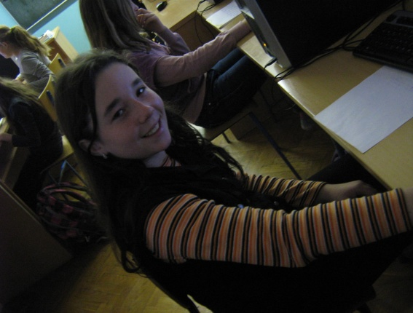
And here’s what they have to say about themselves:
Hello!
My name is Danijela. I am eleven. I live in Seketin. I have got a big family. I have got long brown hair and green eyes. I love small turtles. I have two dogs-German shepherds. I have got a lot friends. My best friends is Irena.<3

Slide 5
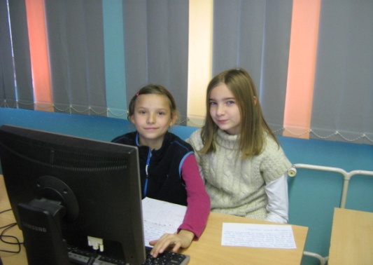
!HeLLO!
I am Sara. I’m eleven years old.I’ve got wavy brown hair and brown eyes.I’m not very tall.I like animals and playing with my friends.
My best friend is Veronika.She has got straight hair and green eyes.She is ten and half years old.
My sister is Lea.She is eleven years old.She has got wavy brown hair and brown eyes , just like me.She is not very tall, but she is nice.
Lea’s best friend is Marta.Marta is tall girl.She has got a brown hair and blue eyes.She is eleven years old too.
☺☺☺☺☺☺

Slide 6
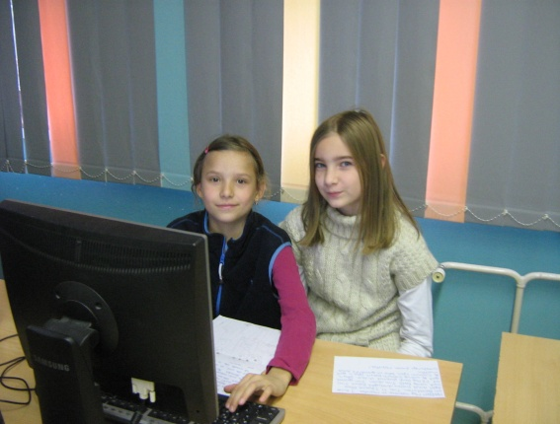

Hallo! ☺
My name is Marta. I’m 11 years old.I have blue eyes and brown straight hair. I’m tall. I’m not plump.I am good at P.E. I have one brother Mihael.My favourite color is purple. My best friend is Lea. She has got wavy brown hair. She is good at P.E. and maths.
Greetings from Marta! ☺

Slide 7
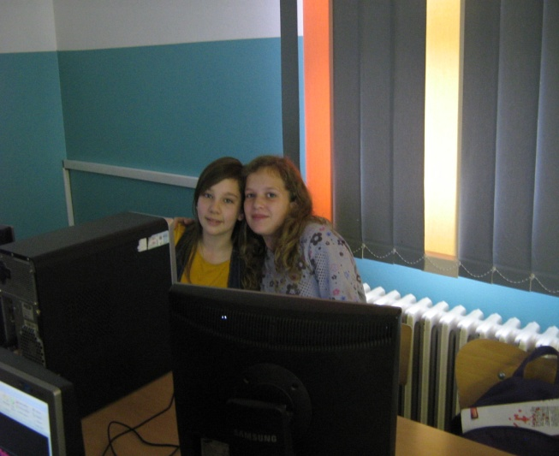
hello!
My name is Ema.I’m 11 years old.
I live in Beretinec,Croatia. <3
My favourite subjects are geography and history.
My least favourite subject is Croatian.
My best friend is Sara. She is cool and funny.
☺ ☺ ☺

Slide 8
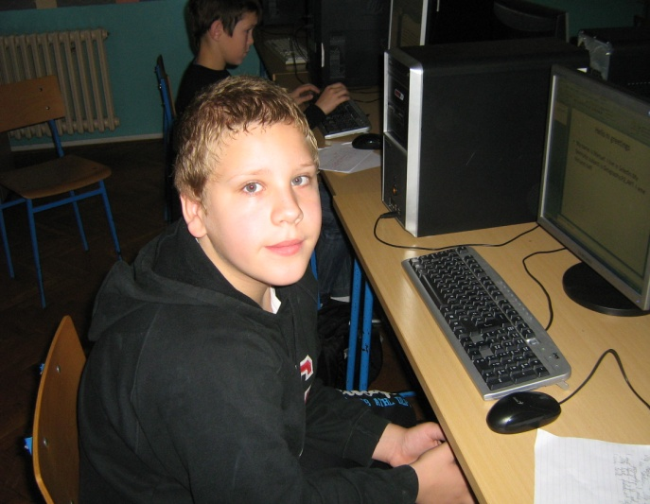
Hello!
My name is Manuel. I live in Seketin.My favoruite subjects are Geography,P.E,ART. I am ten and a half. I’VE got green eyes. My best friends are Stjepan und Teo.I am tall.

Slide 9
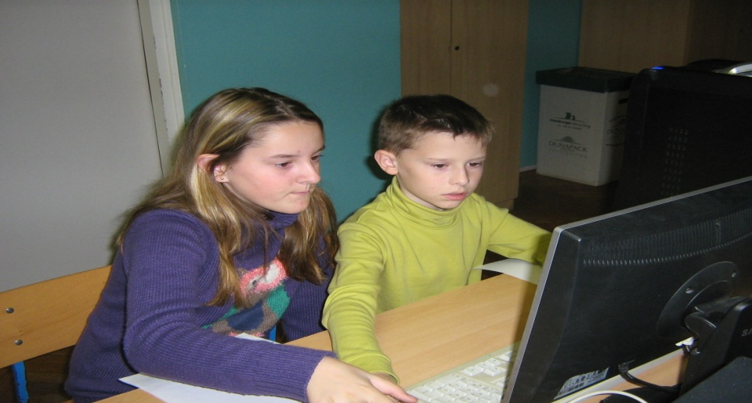
Hello
Our names are Teo and Petra.
We live in Beretinec and Doljan in Croatia.
Our favorite school subject is ICT.
Our least favorite school subjekt is Croatian.
Our favorite pet is a dog.
We are funny.

Slide 10
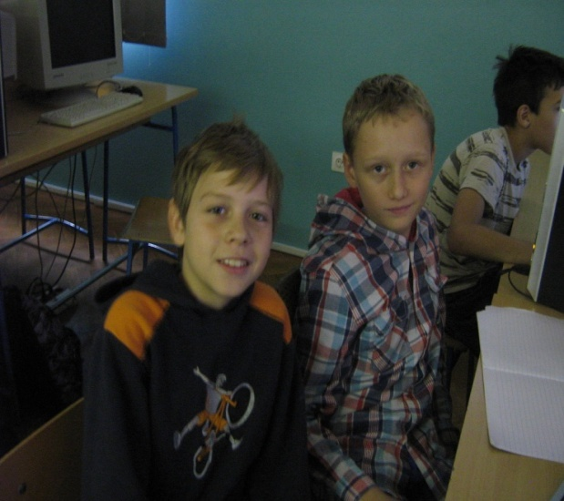
Hello!
Our names are Teo and Vinko.
Teo lives in Beretinec
Vinko lives in Tomsevec
Teo’s favorite subject is P.E.
Vinko’s favorite subject is history.
Teo is 11 years old.
Vinko is 11 years old.

Slide 11
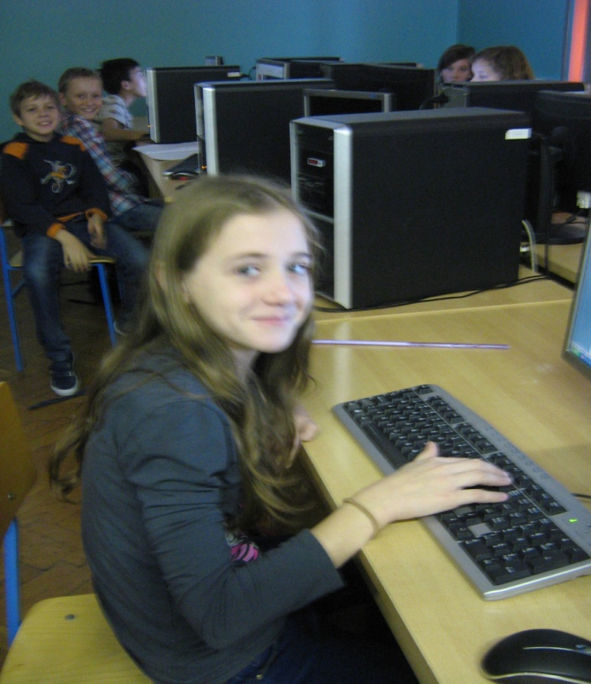
Hello!
My name is Veronika.I live in Seketin.My favorite school subject are p.e and ICT.I ‘love Croatia.My best frend is sara.<3

Slide 12
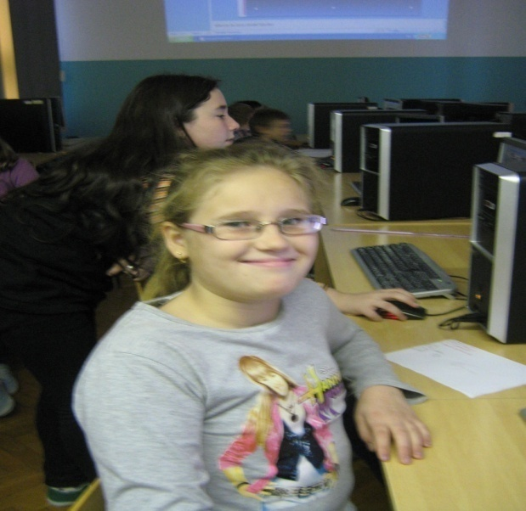
HELLO!
My name is Željka Hrženjak.
I live in BERETINEC.
MY favourite school subject are p.e. and English and ICT.
I’LOVE CROATIA.
MY FRIEND IS EMANUELA KOPIJAR.

Slide 13
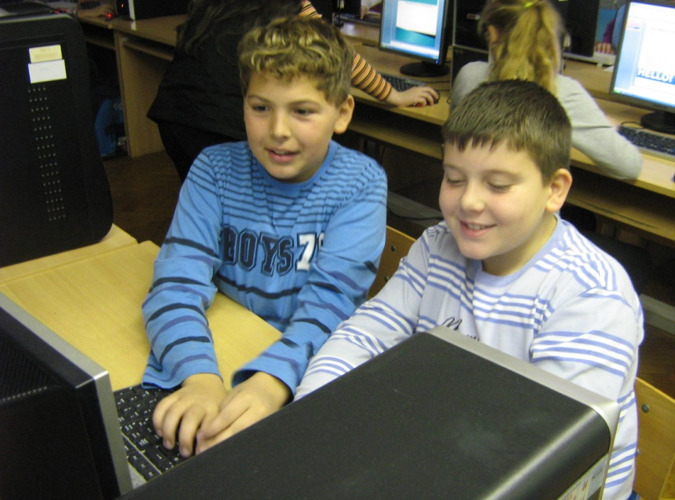
HELLO!!
Our names are Marko and Samuel.
We live in Croatia.Marko lives in Tomaševec,and Samuel lives in Sveti Ilija.
Marko is eleven years old and Samuel is ten years old.Marko is good at football and Samuel is good at computer games. We have many hobbies .Our hobby is jogging.
We love ENGLISH and ICT.
WE ARE GOOD FRIENDS.

Slide 14
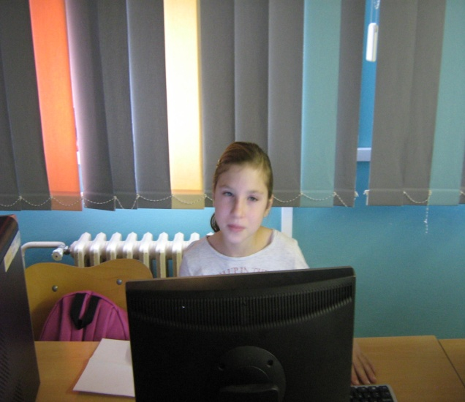
Hi
My name is Emanuela. I live in Sveti Ilija. I’m 12 years old. My best friend is Monika.

Slide 15
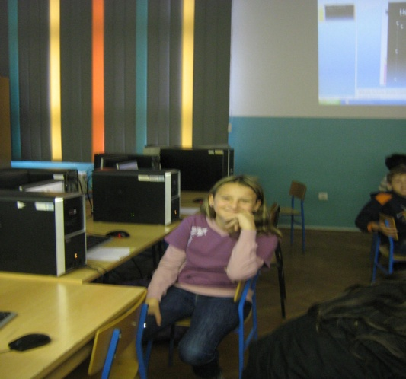
Hi!
My name is Irena. I’m going to fifth class. I live in Sveti Ilija, small village near Varaždin. I have two sisters: Iva and Lucija. They are sometimes boring. My family is big. I don’t like winter because then it is cold. I don’t now why, but this is so. I like jokes. This makes me happy. I have four pets. One dog, one cat and two birds. I can play the guitar. I have many friends. My best friend is Marta. She is born on the same day as I. We often make up jokes together.

Slide 16
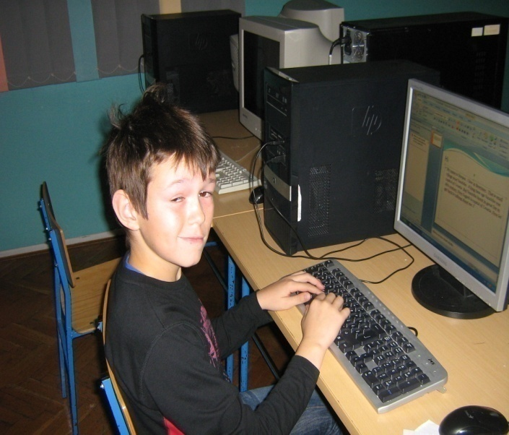
Hi
My name is Stjepan . I live in Beretinec . That is small village near Varaždin . A long time ago Varaždin was capital of Croatia .But Varaždin burnt in great fire in 18th century .Now Zagreb is capital of Croatia .Now let’s get back to talking about me. I’ve got brown hair and brown eyes .I am not very tall but I am not short. That will be all from me. Goodbye.

Slide 17
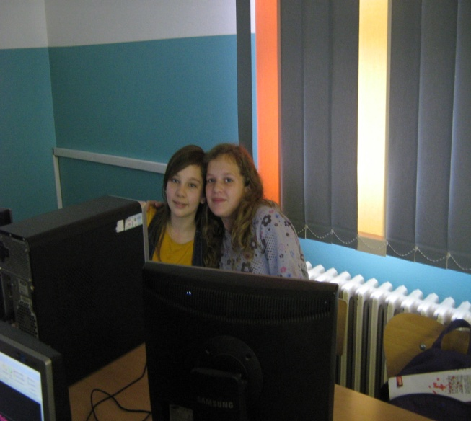
Hi , my name is Sara.I live in Beretinec,Croatia. .I’m 11 years old. My favourite subject is history.
Ema is my best friend in my class and she is clever and cool .
My least favourite subject is Croatian.

Slide 18

My school is big! I have a lot of friends.They are cool, you have to see it.We are excited.
I’ts great to write to you Manfred.
SAra

Slide 19
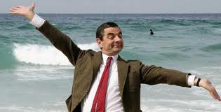
Well, that’s all for now.
Have a nice day!
☺

