Slide 1
Manfred in Greece
Three days with Kostantis & Nickolas
5th Grade
5th Elementary School Of Volos, Greece

Slide 2
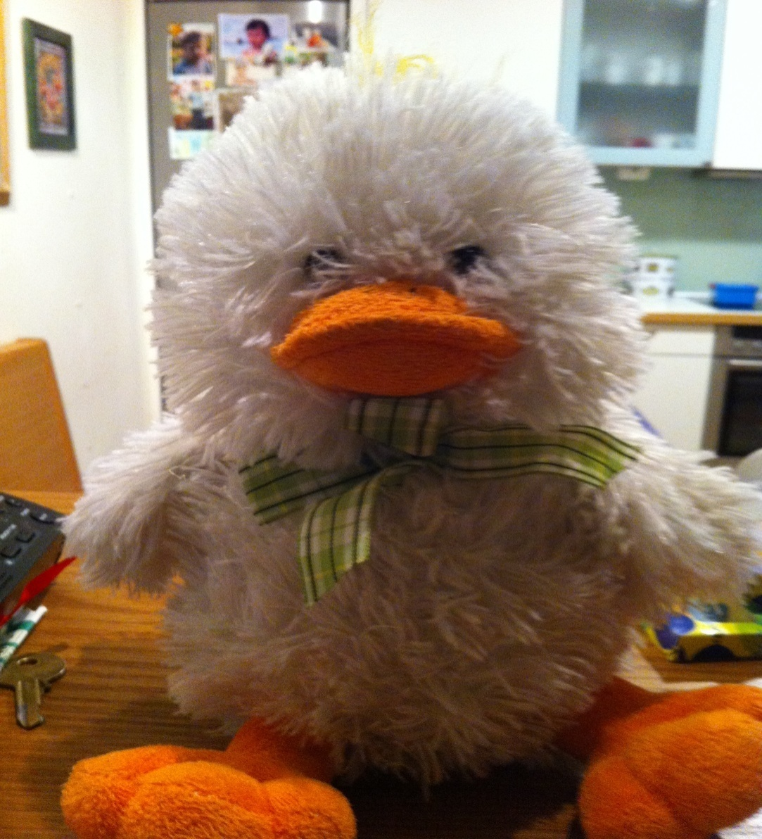
Manfred likes eating Greek food.
Now he is eating breakfast in Kostantis’ kitchen

Slide 3
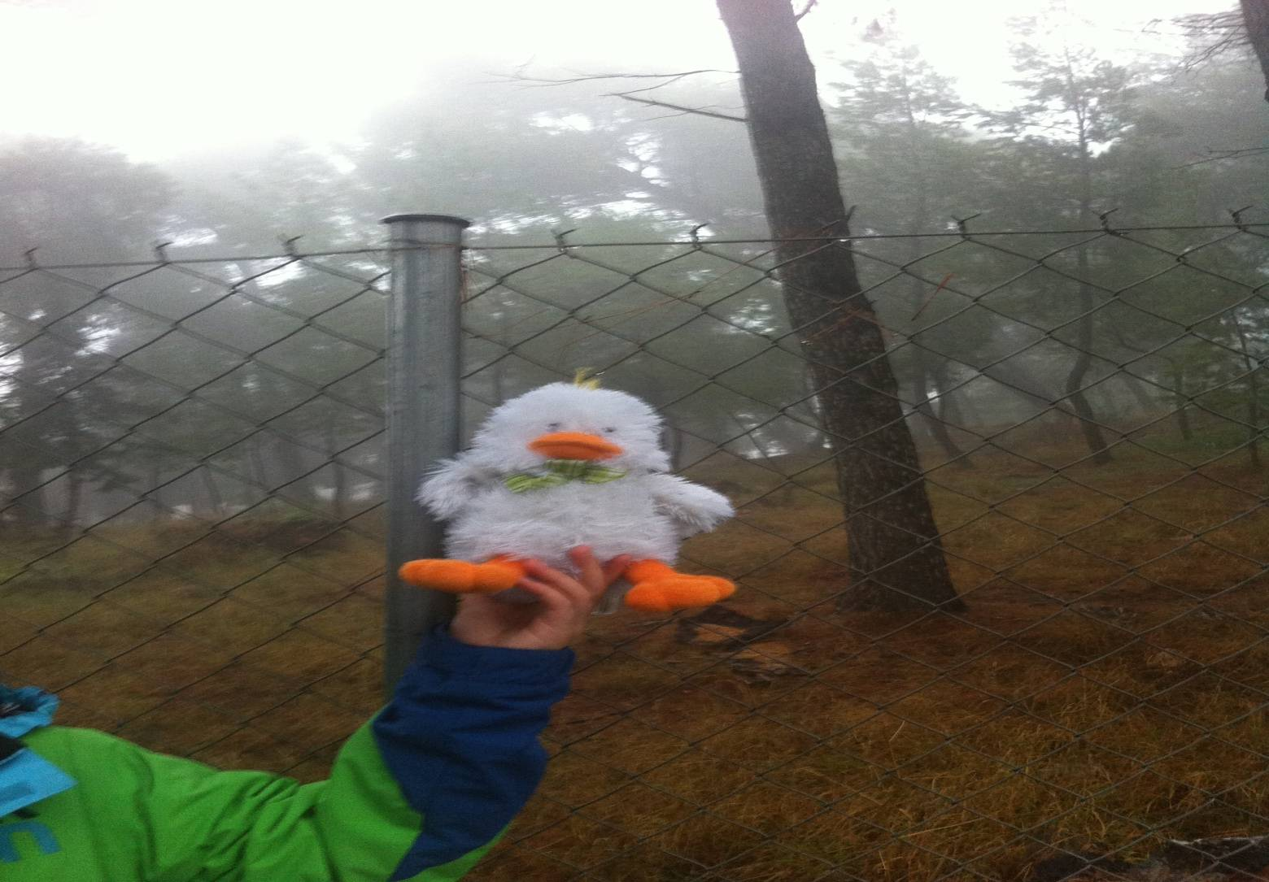
Manfred also likes walking.
Here he is in a forest with Kostantis

Slide 4
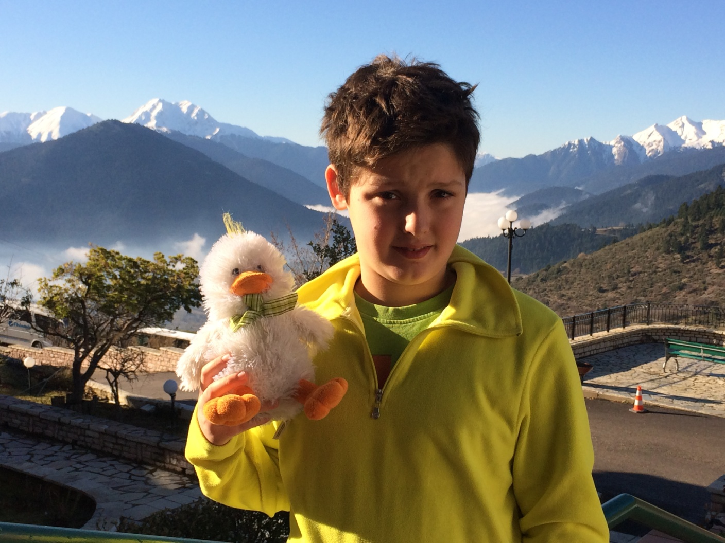
Manfred & Nick in Velouchi Mountain
Manfred likes the fresh air…

Slide 5
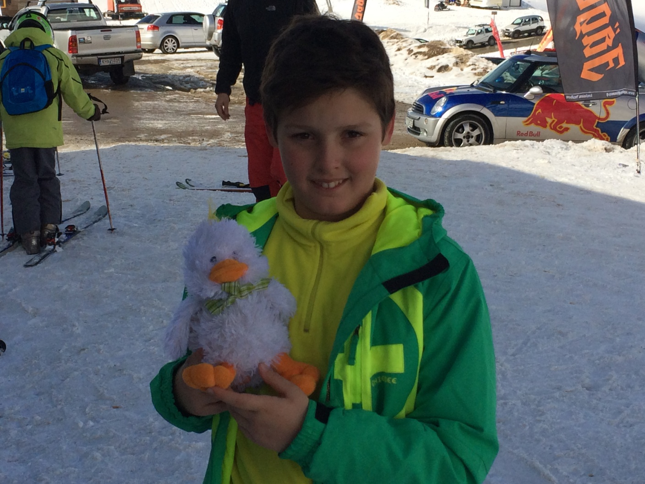
Skiing with Manfred in Velouchi ski resort
Manfred loves skiing!!!

Slide 6
We had a wonderful time with Manfred!!!!
Hope to see him soon….
Kostantis & Nickolas

