Slide 1
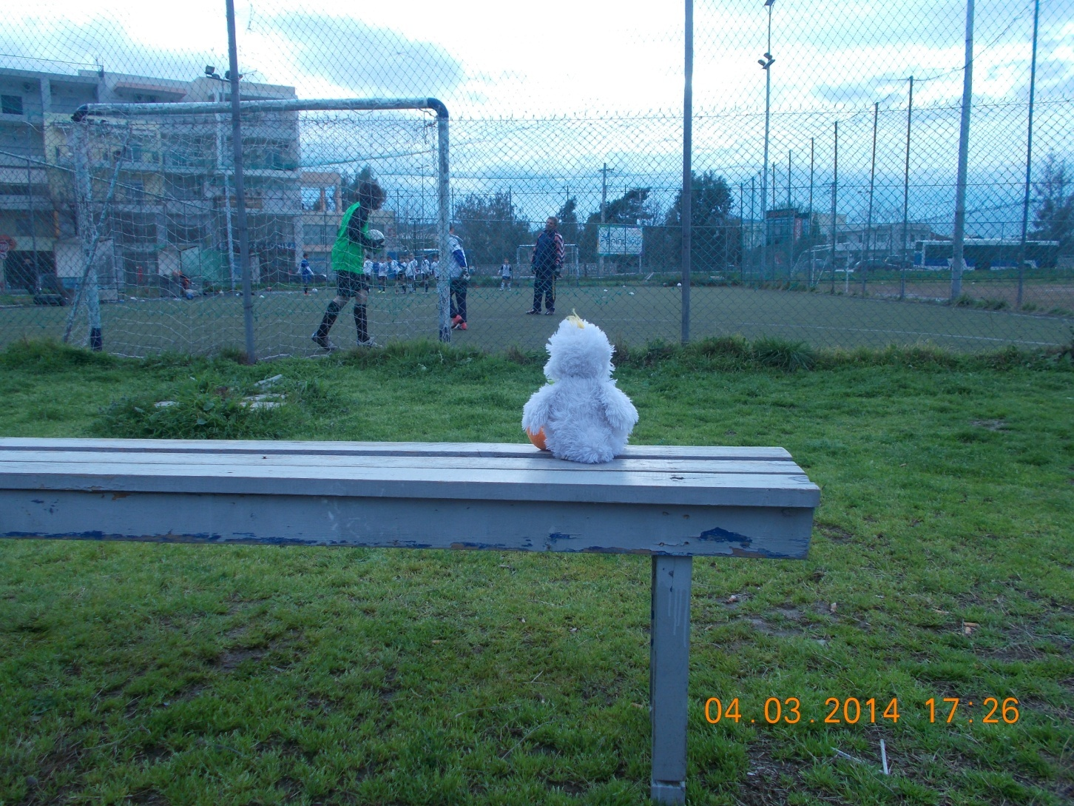
Manfred watches a football game.

Slide 2
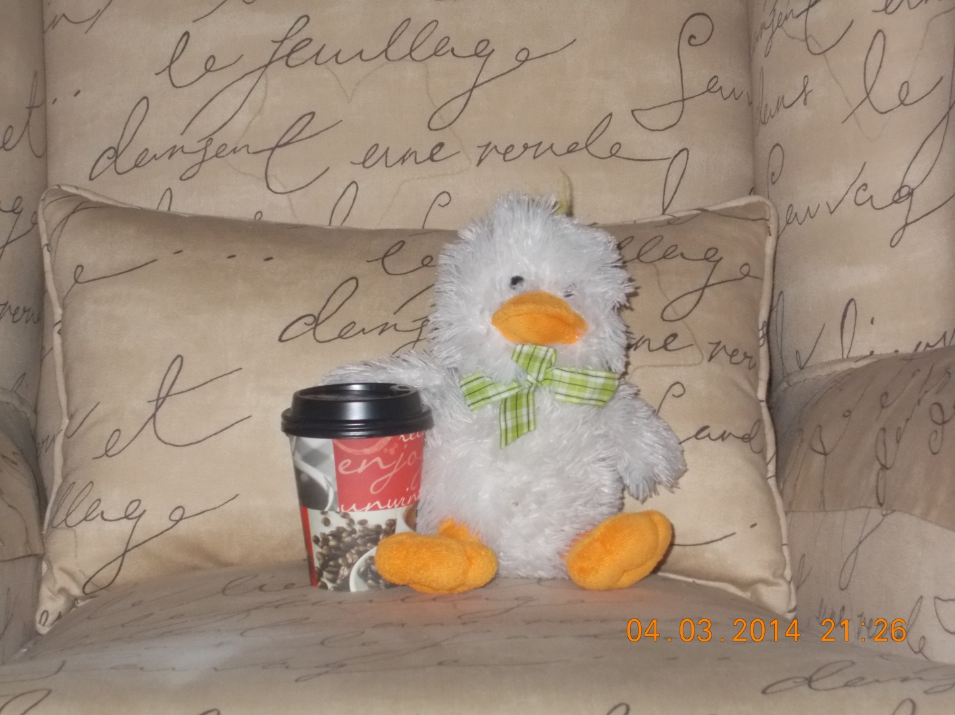
Manfred enjoys his coffee.

Slide 3
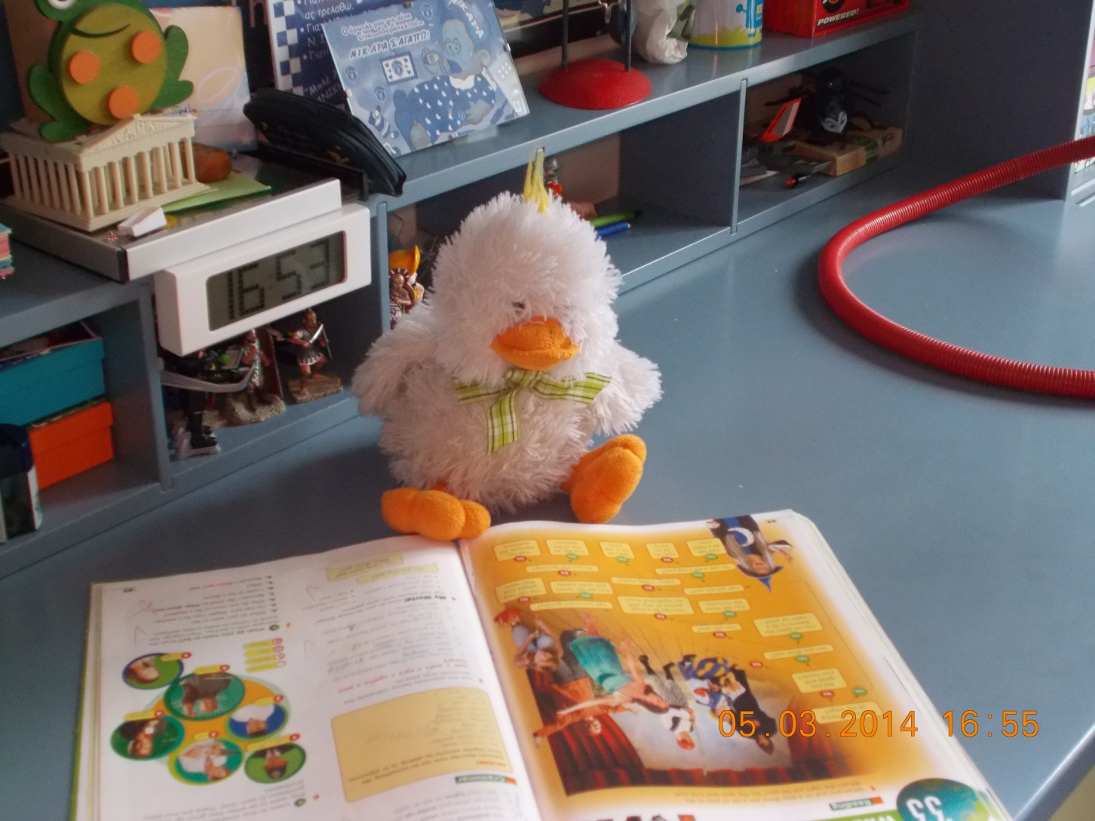
Manfred reads his book.

Slide 4
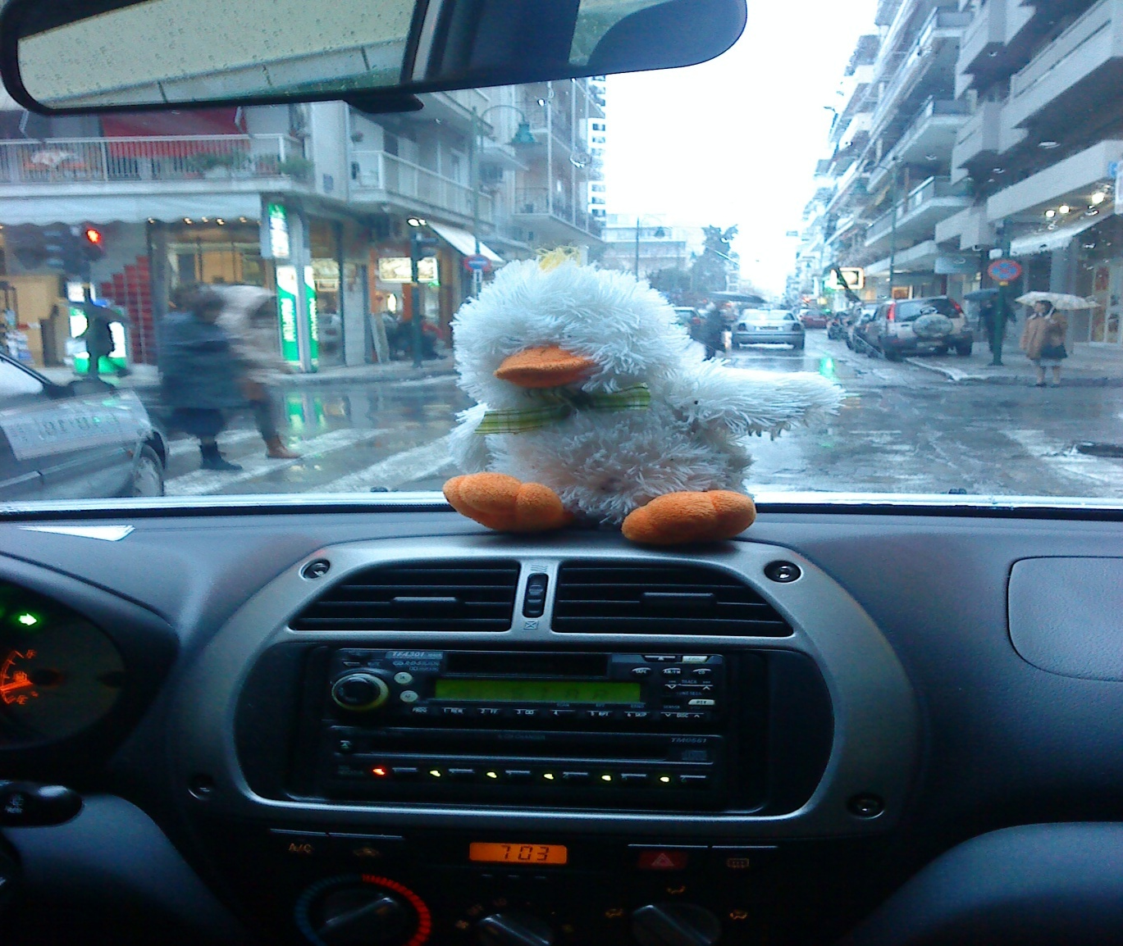
Manfred travels by car.

Slide 5
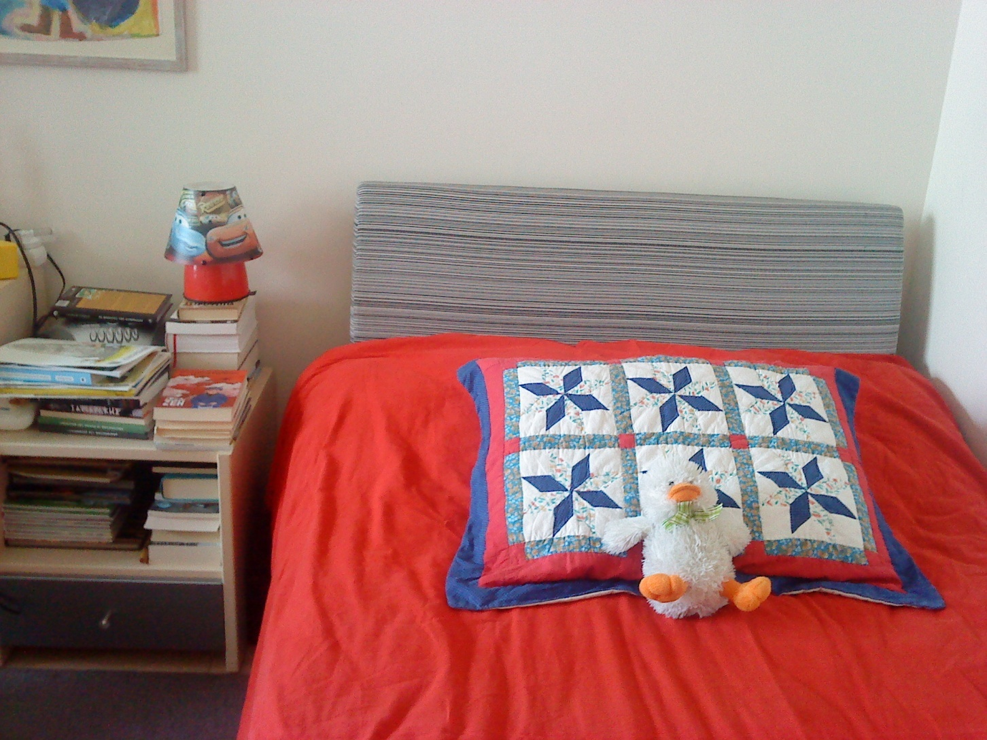
Manfred sleeps.

Slide 6
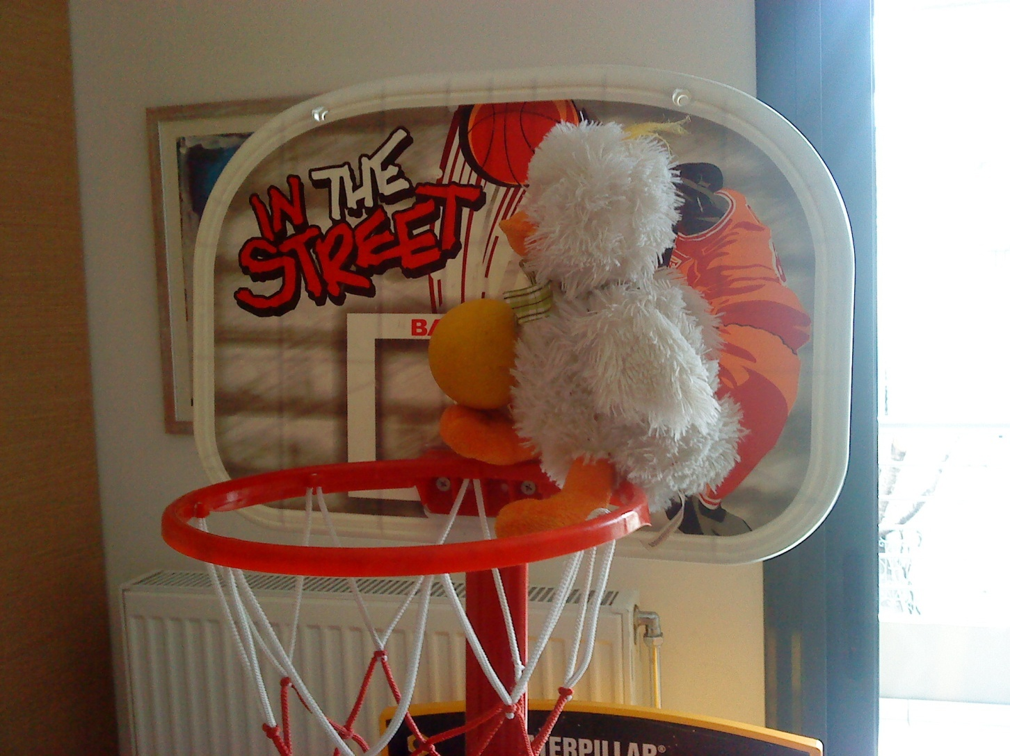
Manfred plays basketball.

Slide 7
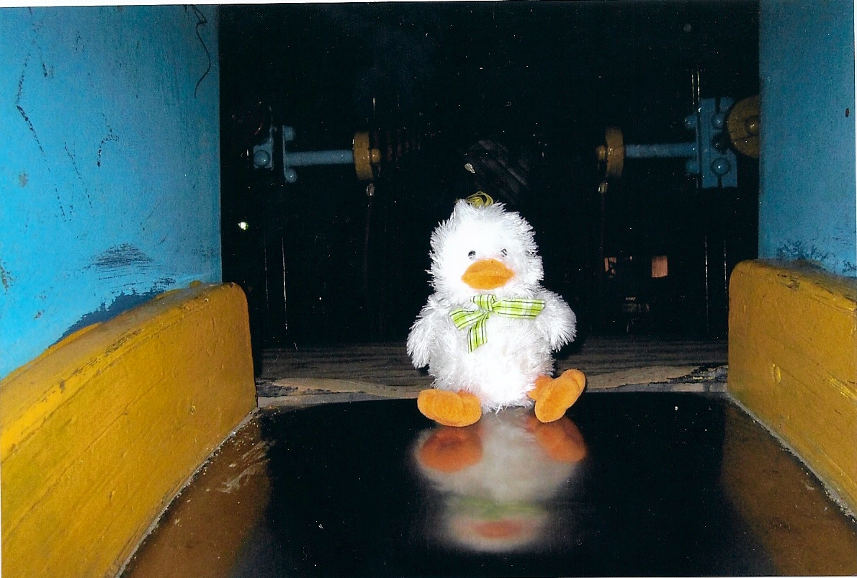
Manfred plays in the park.

Slide 8
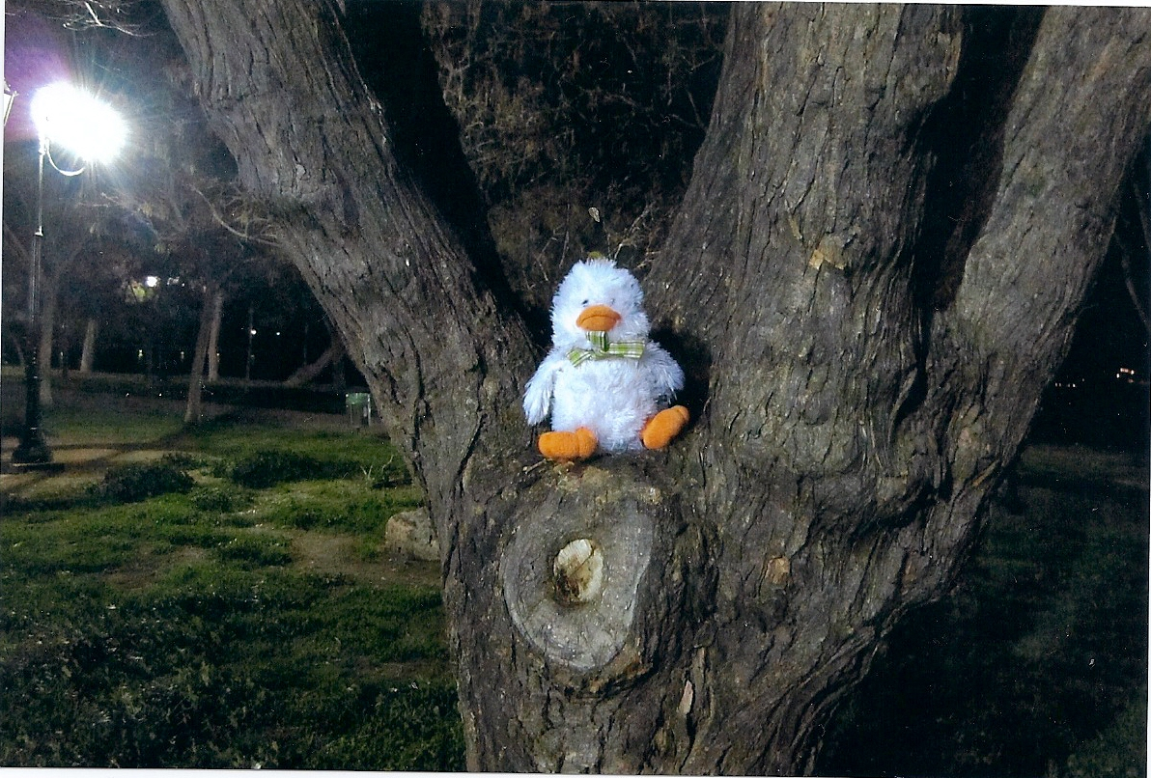
Manfred climbs on a tree.

Slide 9
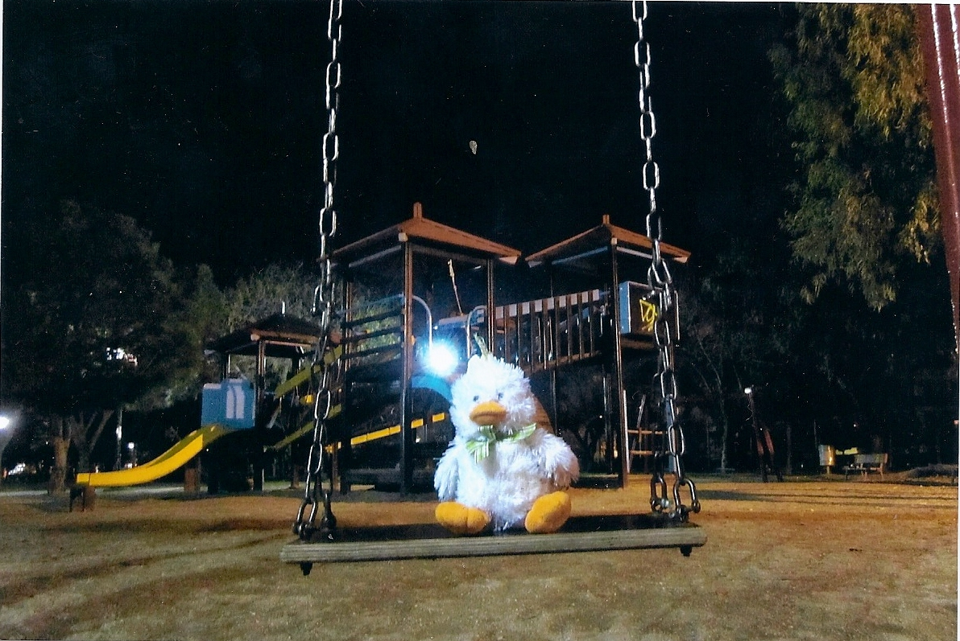
Manfred plays with the swing.

